Slide 1
2004 Cross-shelf

Slide 2
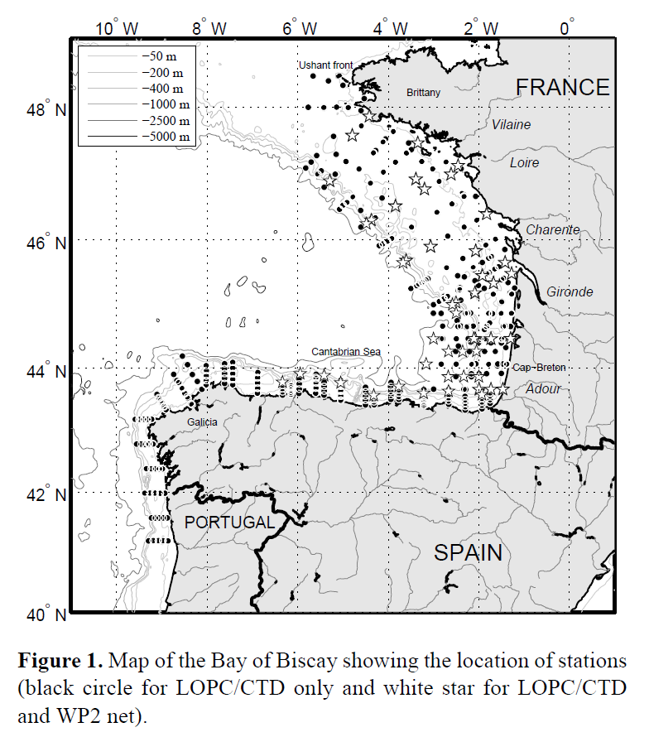
Vandromme 2014 summary
LOPC attached to CTD Rosette, sampled downward casts
Depth integrated samples
> 700 casts in spring (2005 – 2012) in Bay of Biscay
Large focus on comparing LOPC to net samples

Slide 3
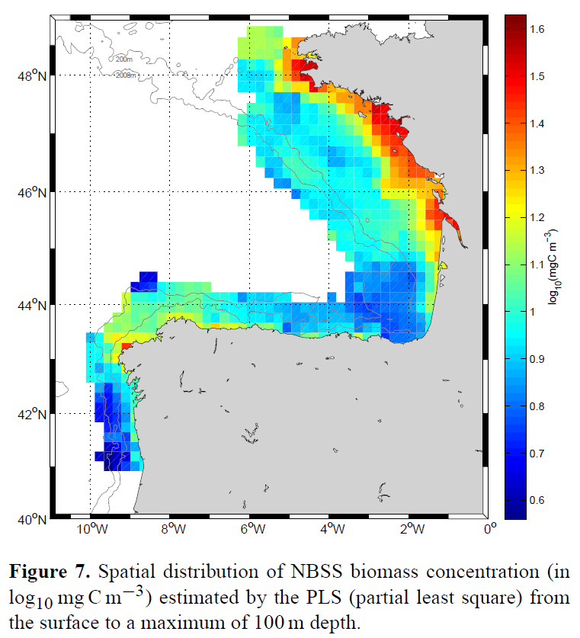
Vandromme 2014 summary
Biomass has strong spatial patterns
High in NE coastal area, low in SE coastal area
Onshore-Offshore gradient

Slide 4
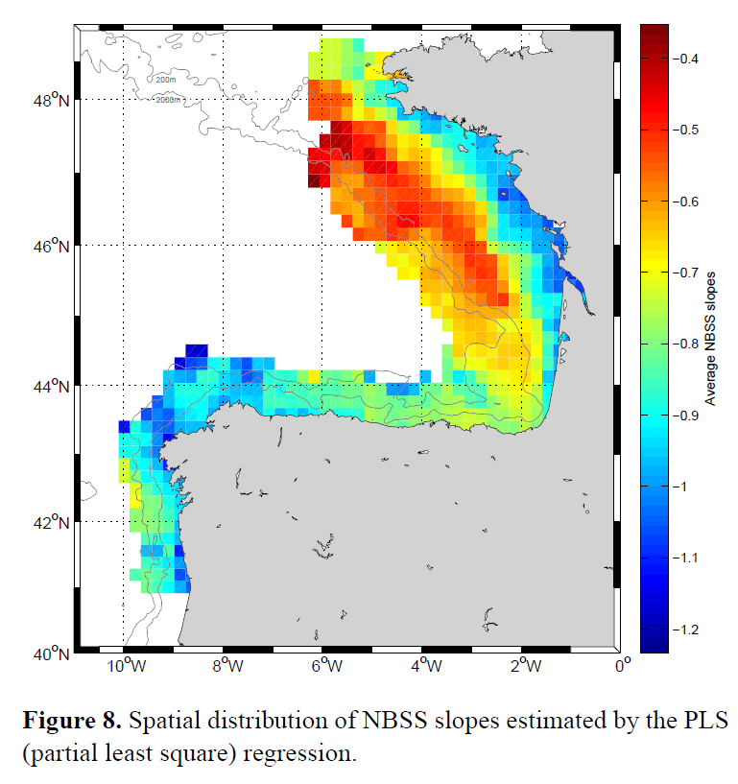
Vandromme 2014 summary
NBSS shows similar spatial patterns to Biomass
Steep slope in NE with offshore gradient to very shallow
Less of a gradient in SE

Slide 5
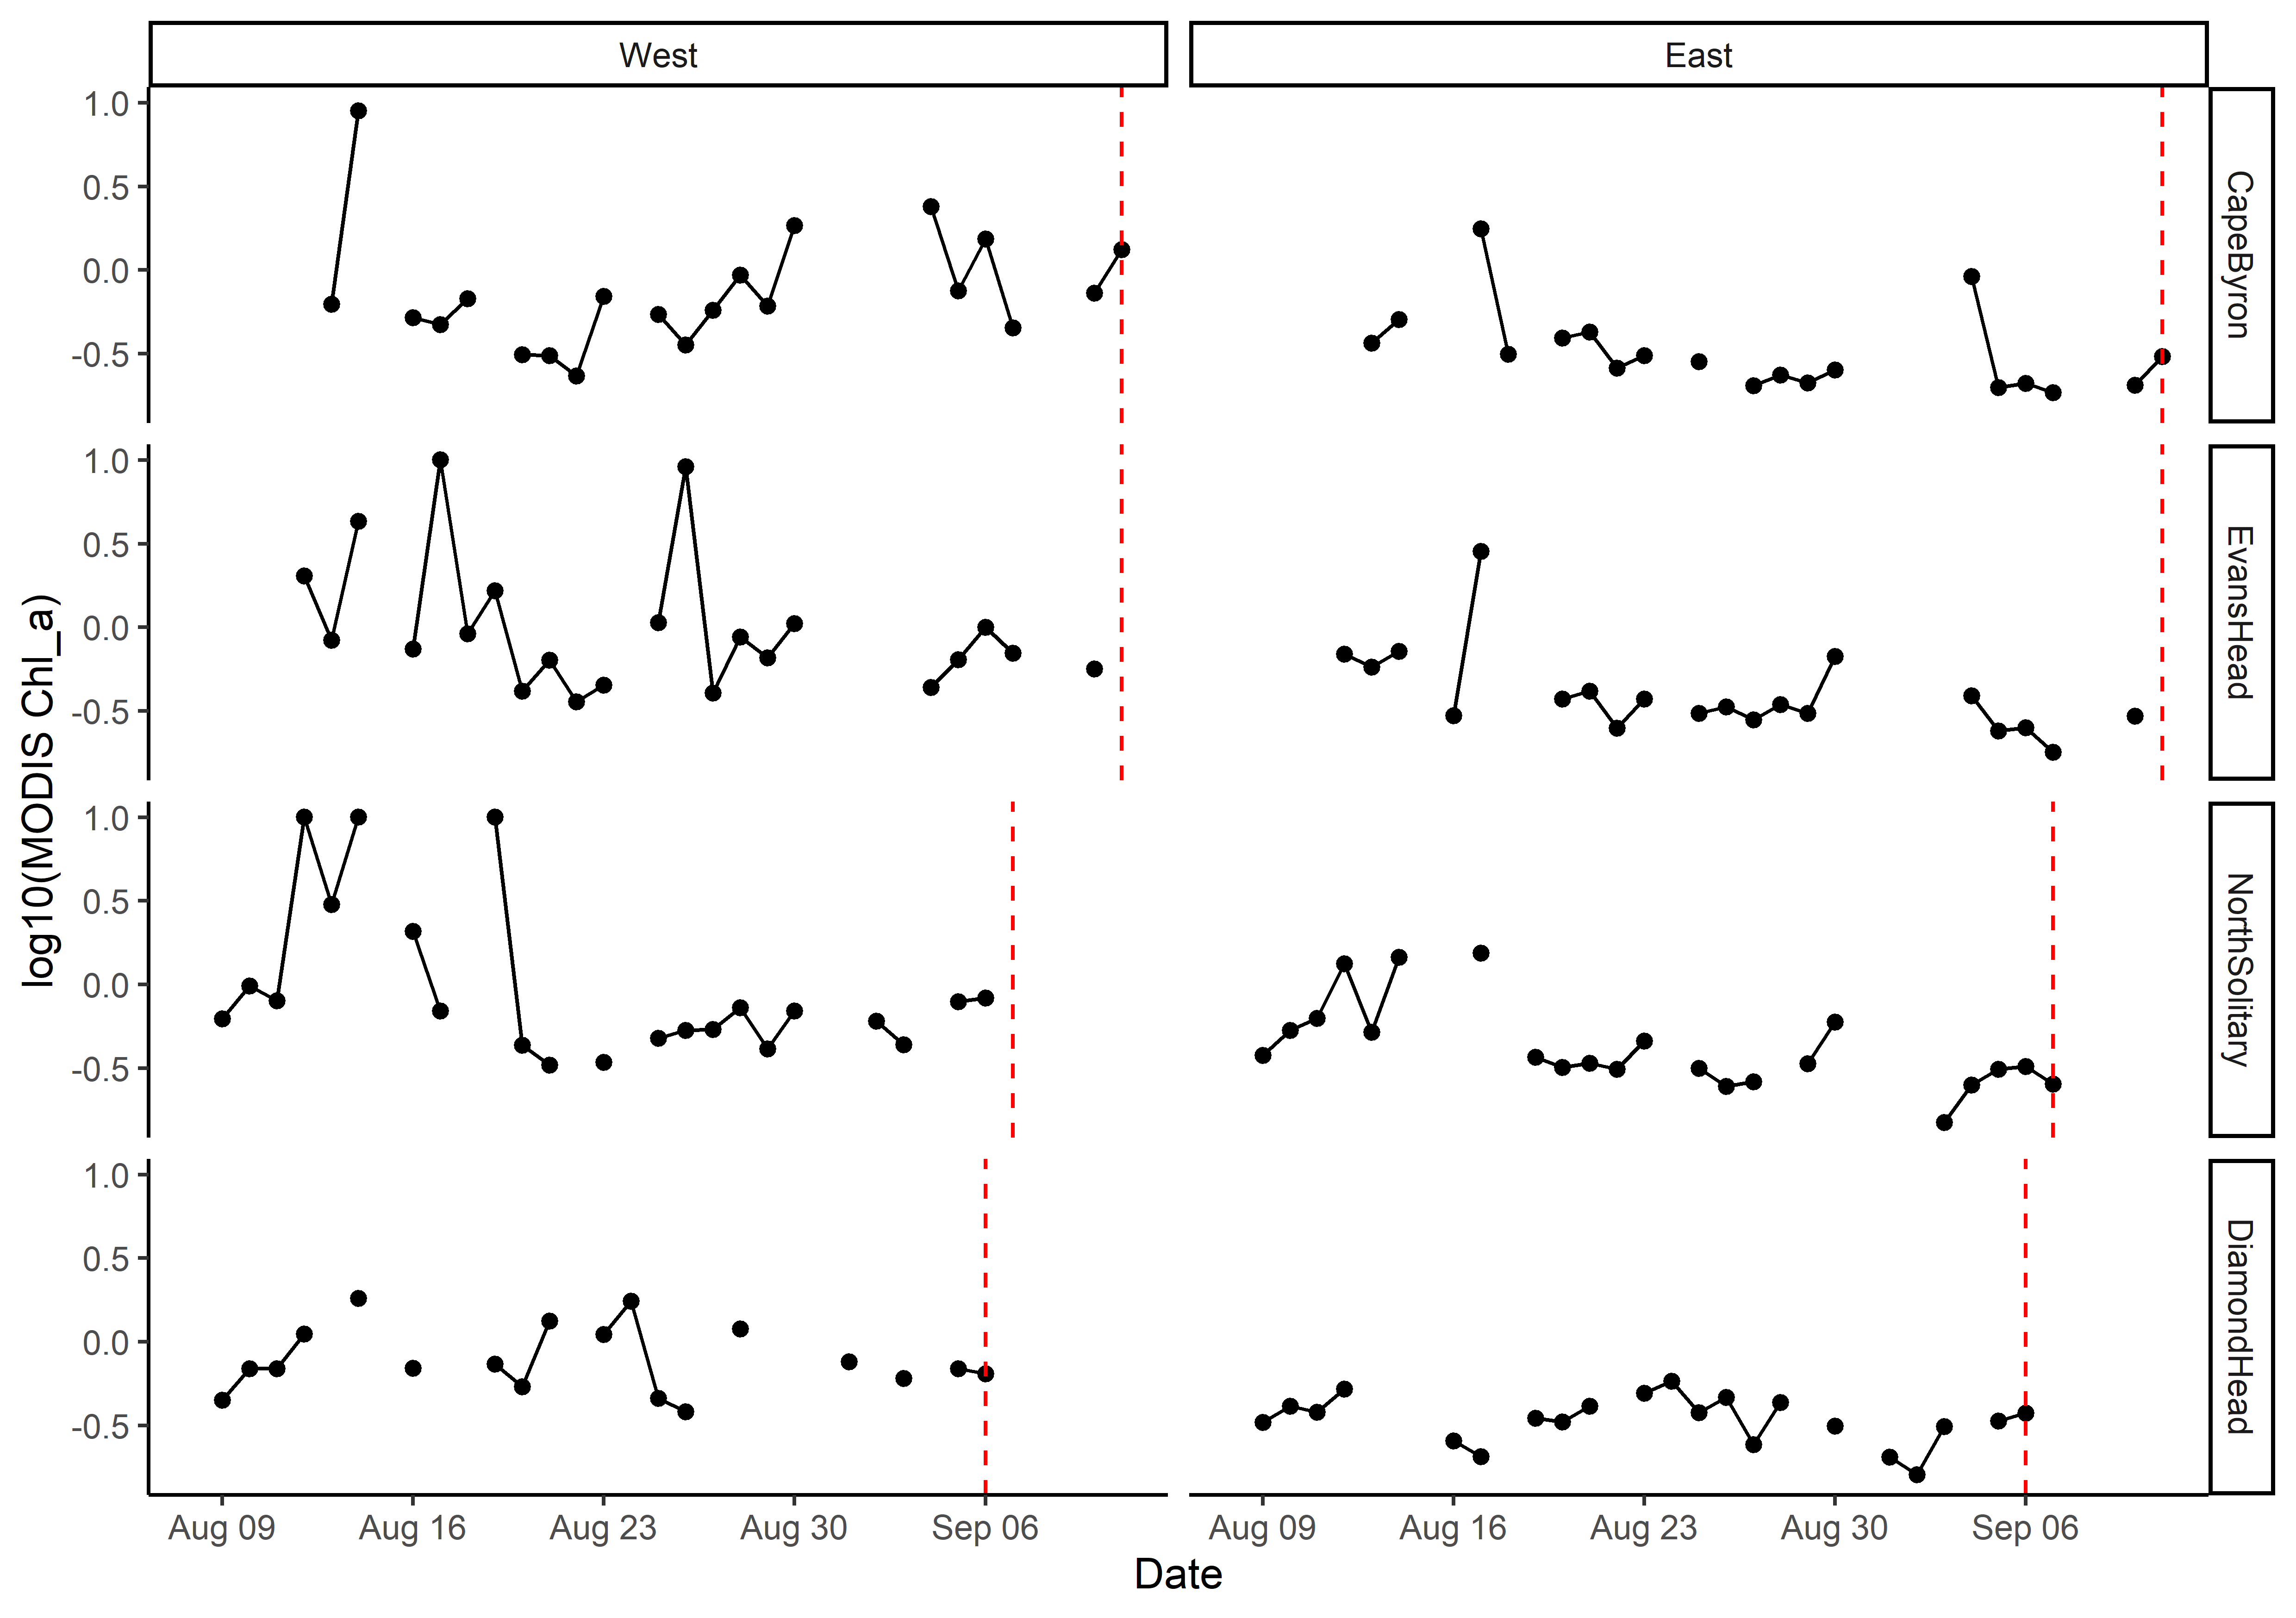
MODIS Chlorophyll a
Values >10 rescaled to be = 10
Log₁₀ transformed

Slide 6
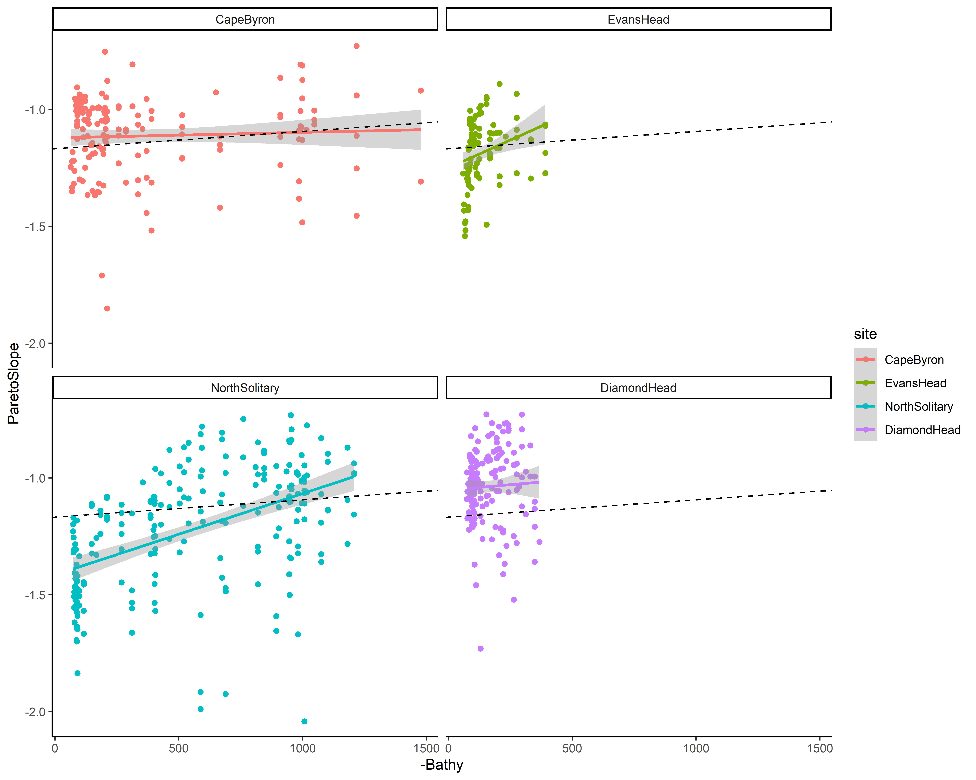
NBSS Pareto Slope
Dotted line is overall mean

Slide 7
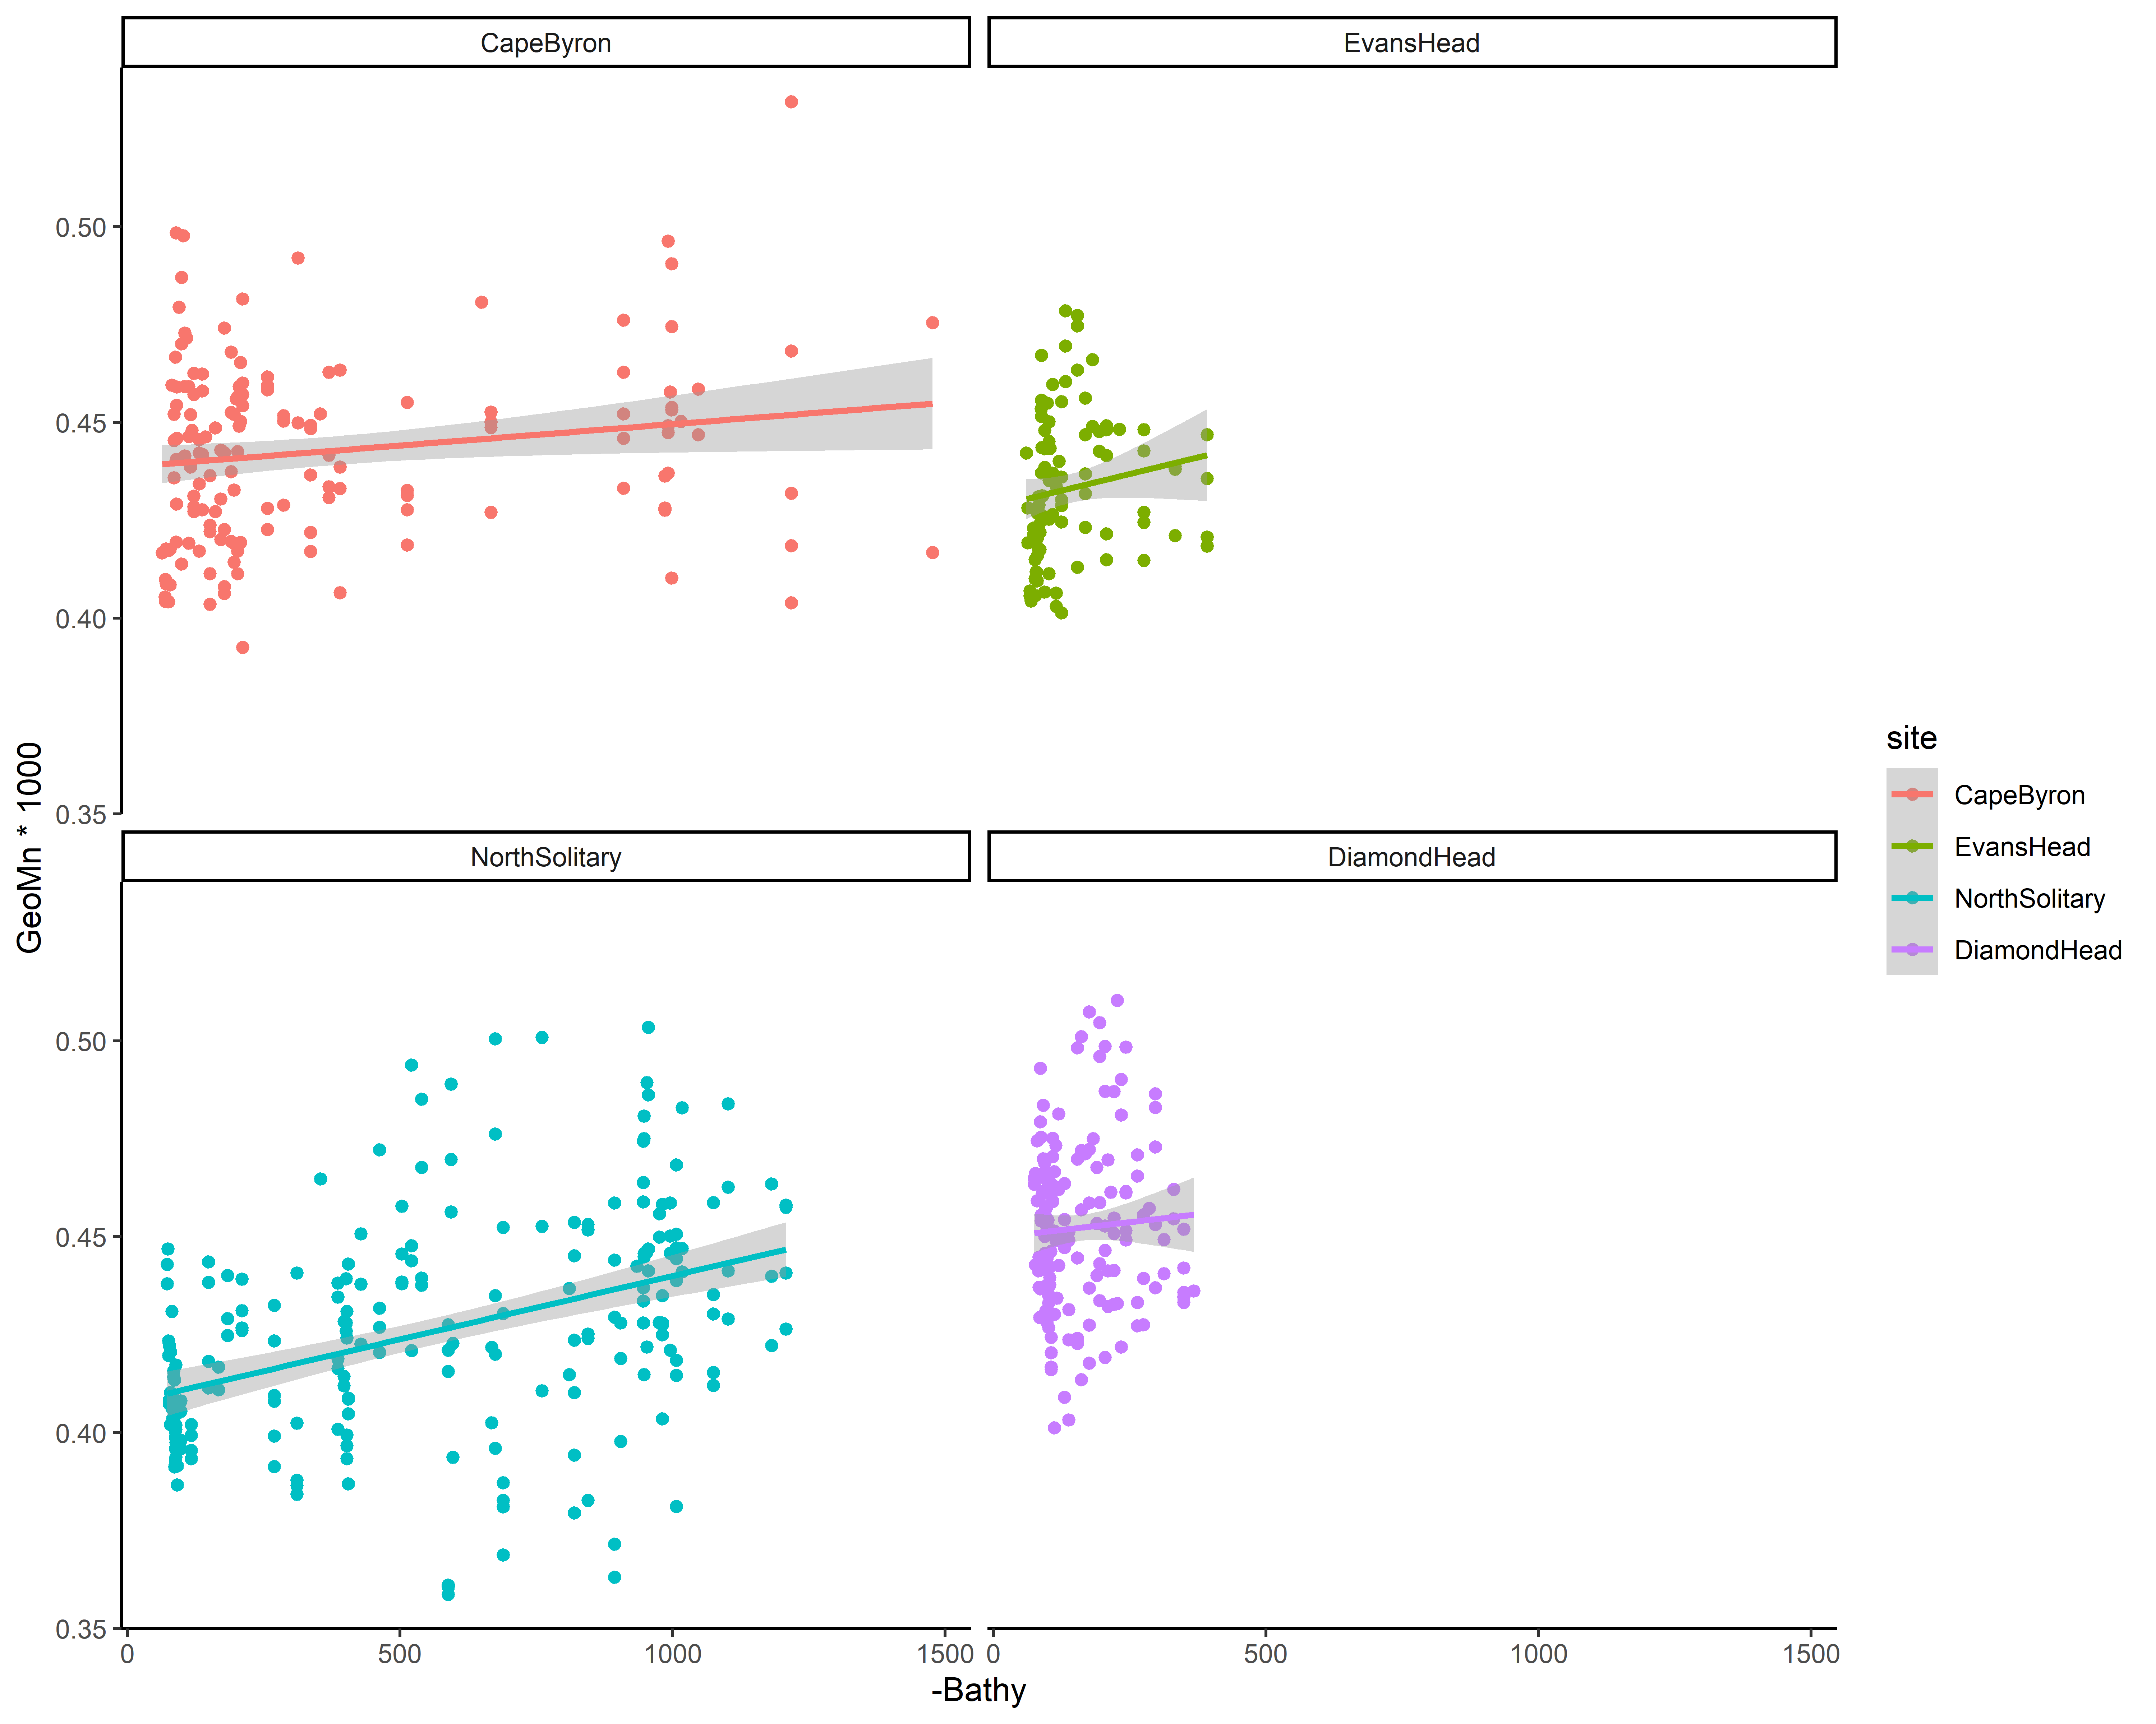
Size

Slide 8
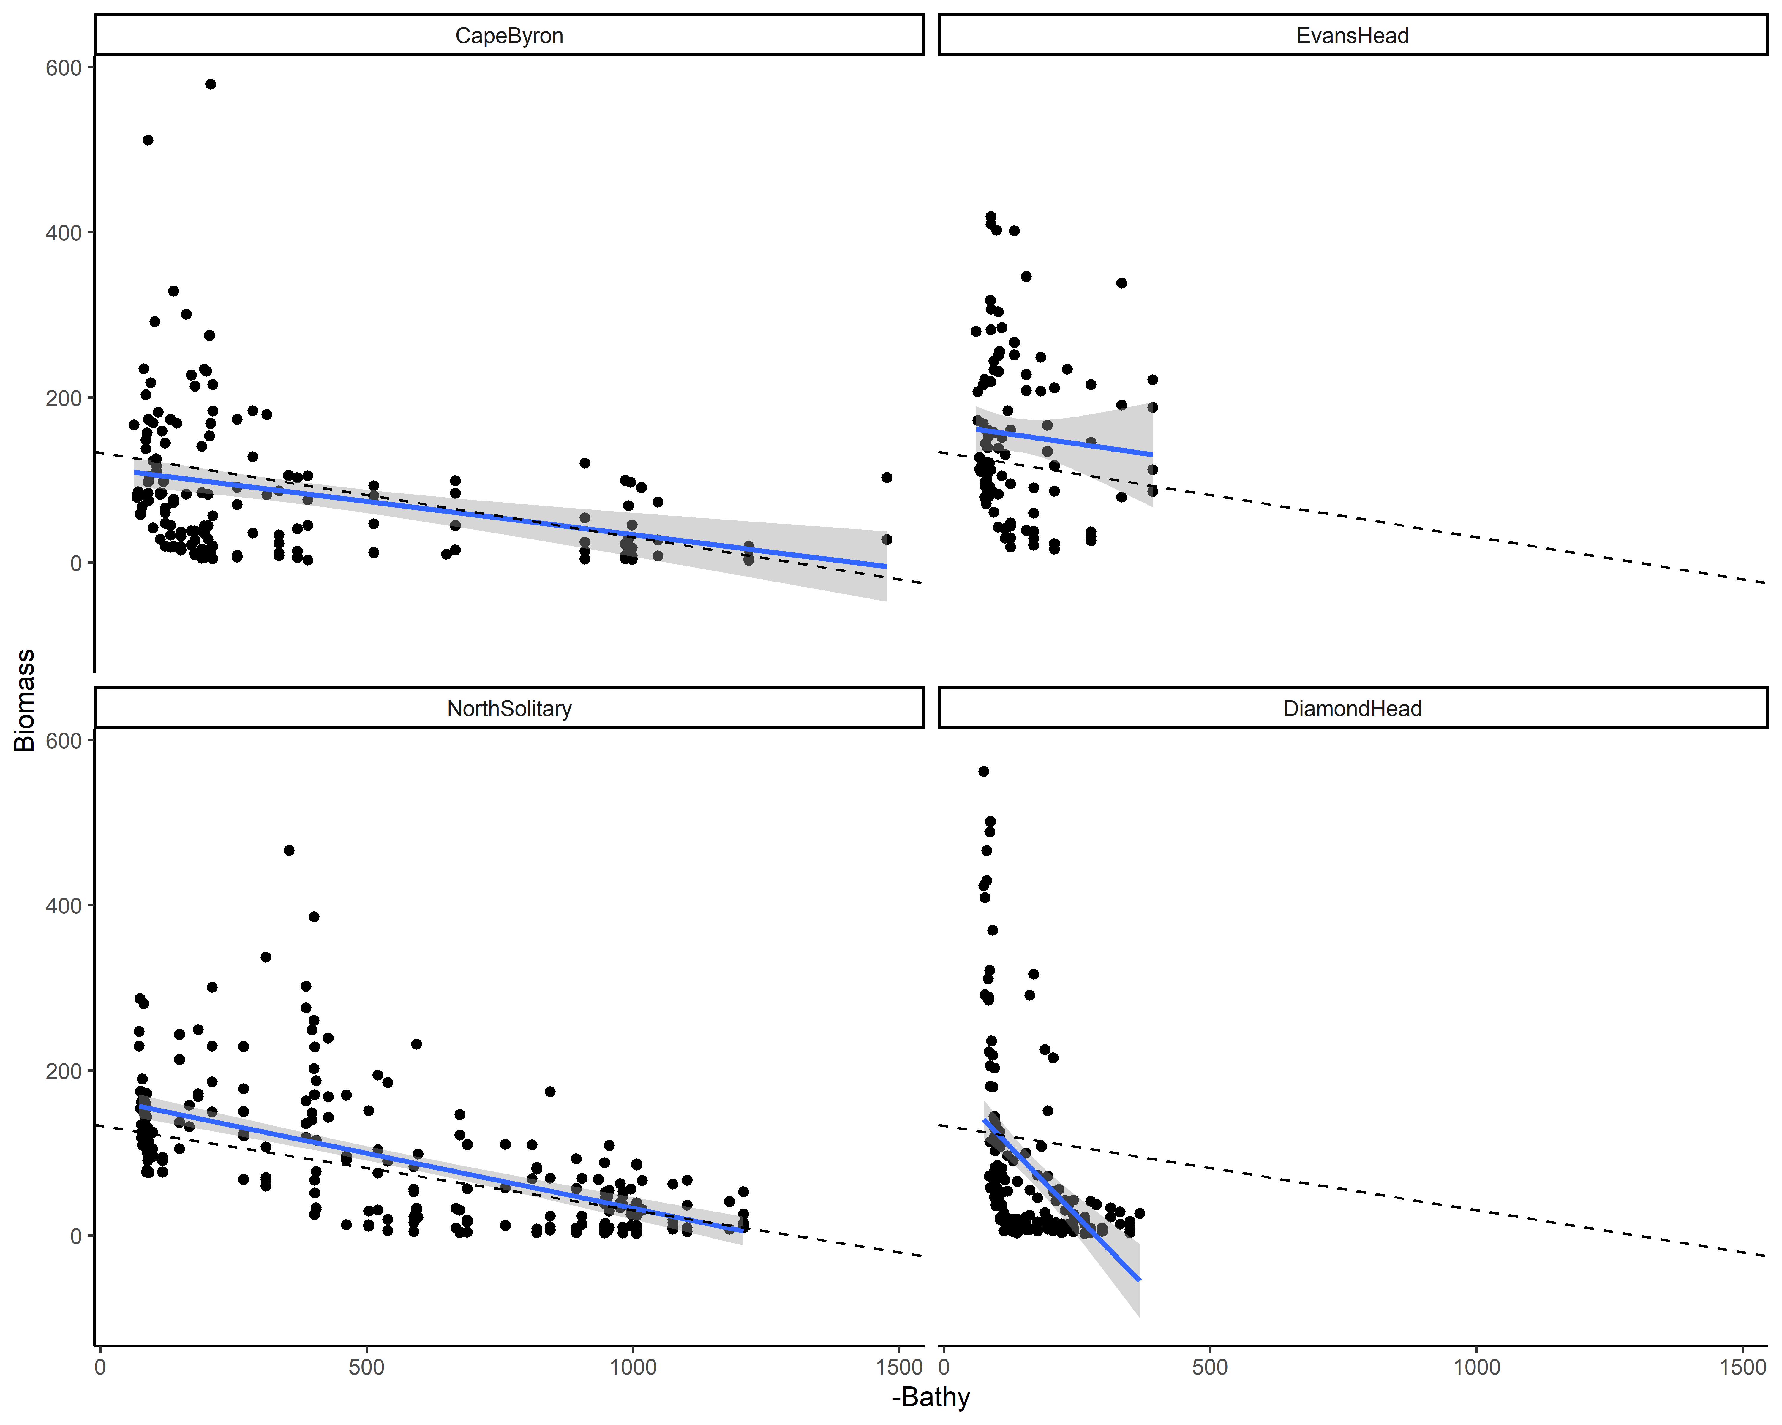
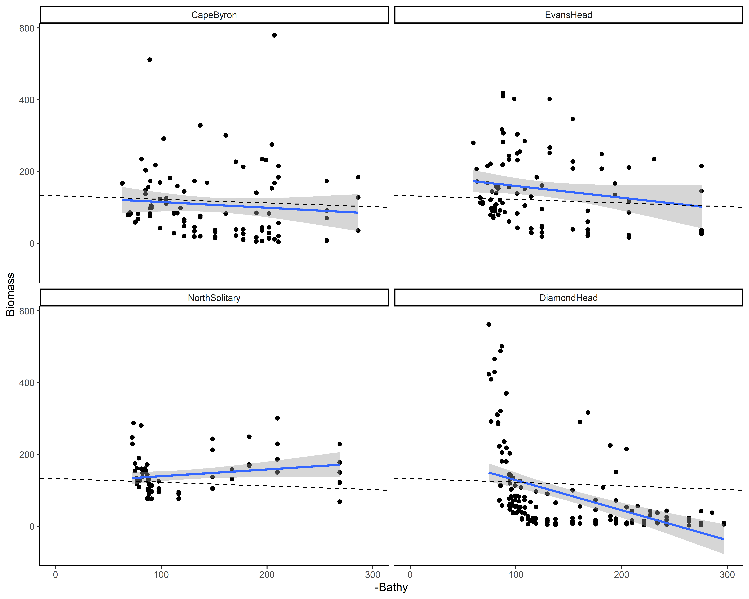
Biomass
Dotted line is overall mean

Slide 9
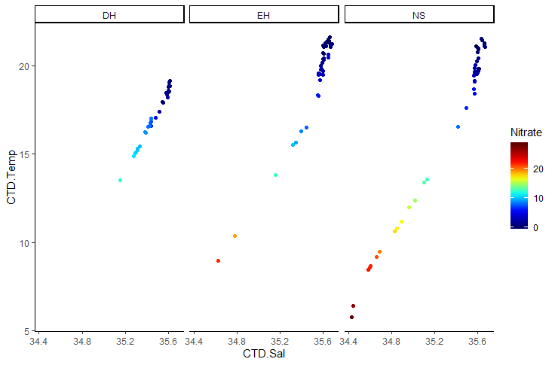
T-S Plot all depths (CTD)

Slide 10
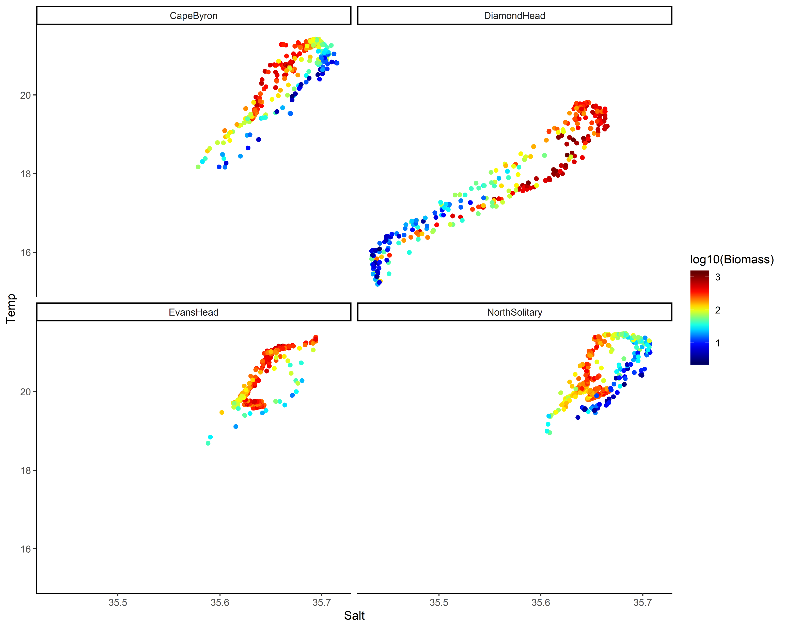
TS Plot by log₁₀(Biomass)

Slide 11
Key Questions
Aim: Describe the water and zooplankton characteristics across the East Australian shelf.
Water characteristics – physical oceanography
Zooplankton characteristics
Are they linked?
What is the larger context of these transects?

Slide 12
Water Characteristics
3 Transects go from inshore to EAC
Diamond Head is in a separation zone
See V-rotated velocities and Temperature
2 types of water mass, EAC influenced and separation zone
Compare northern 3 to Diamond Head

Slide 13
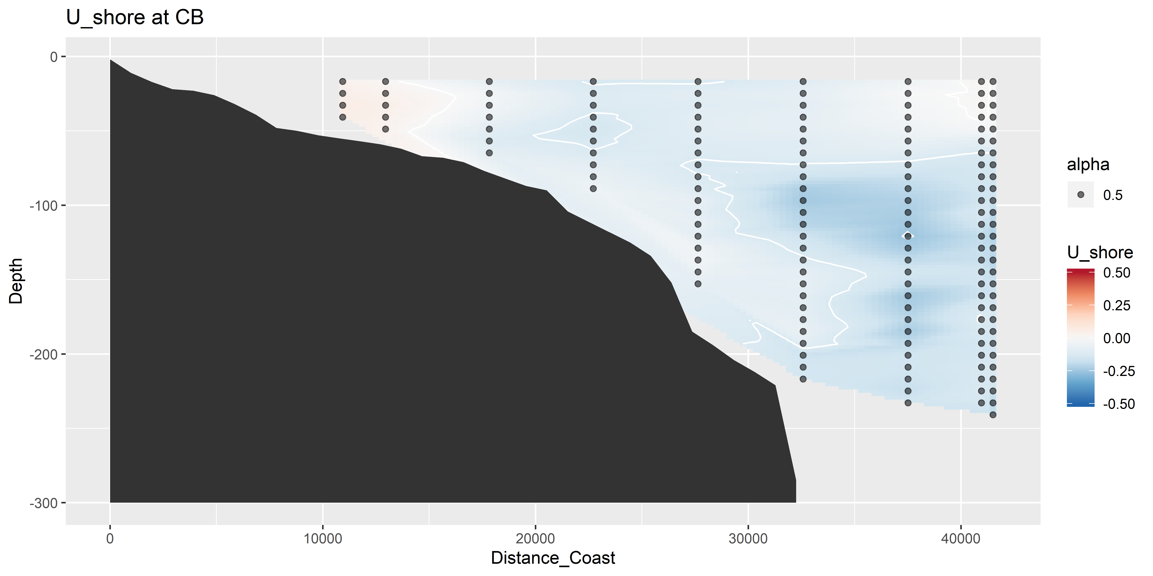
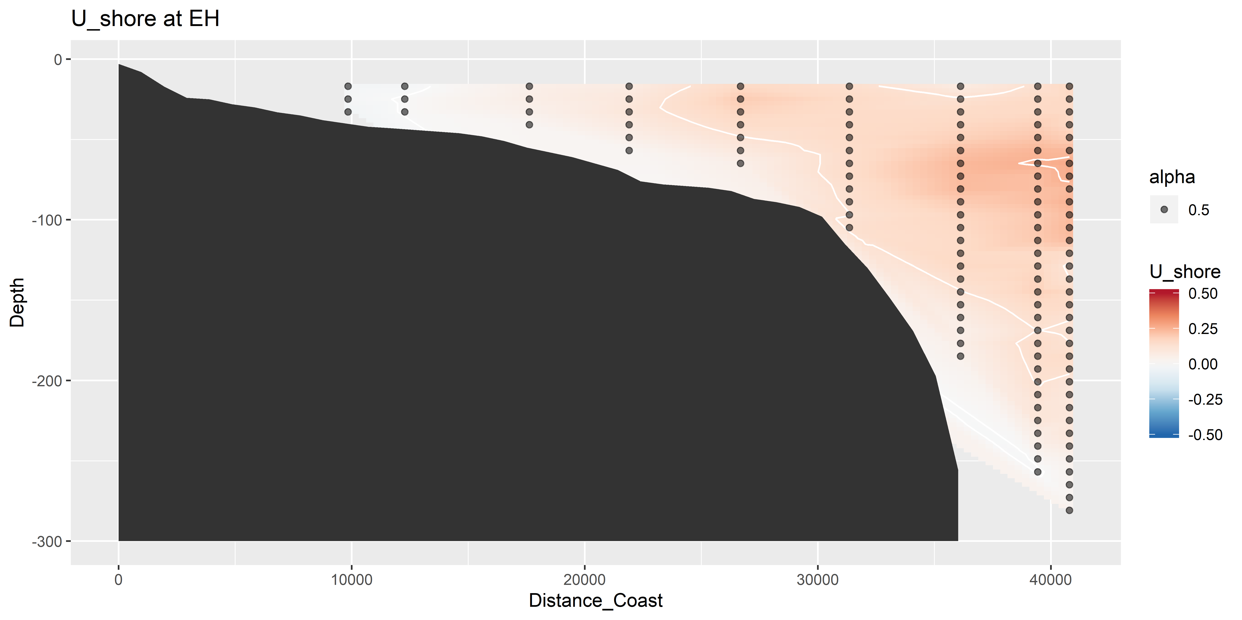
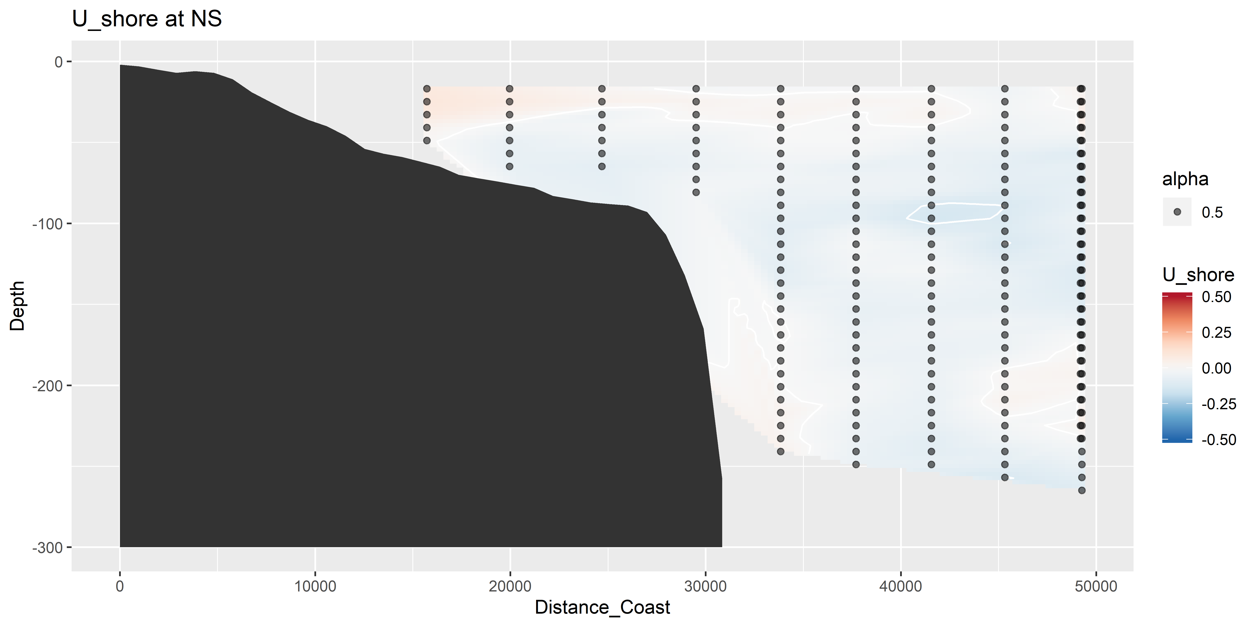
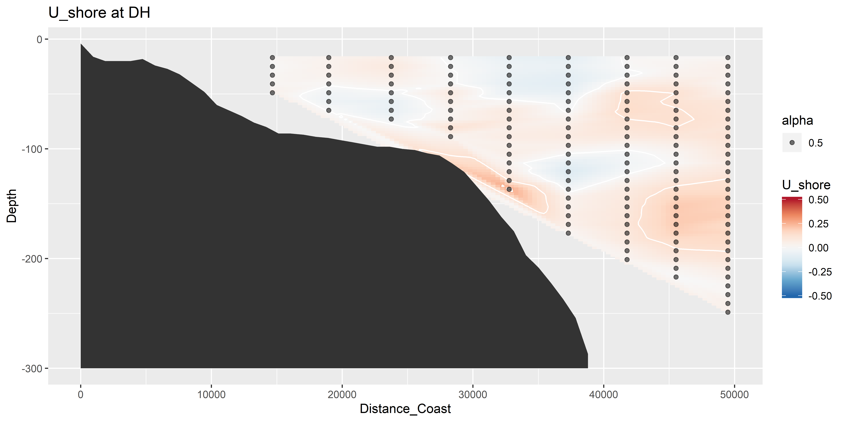
U vectors – shoreline rotated (m s⁻¹)

Slide 14
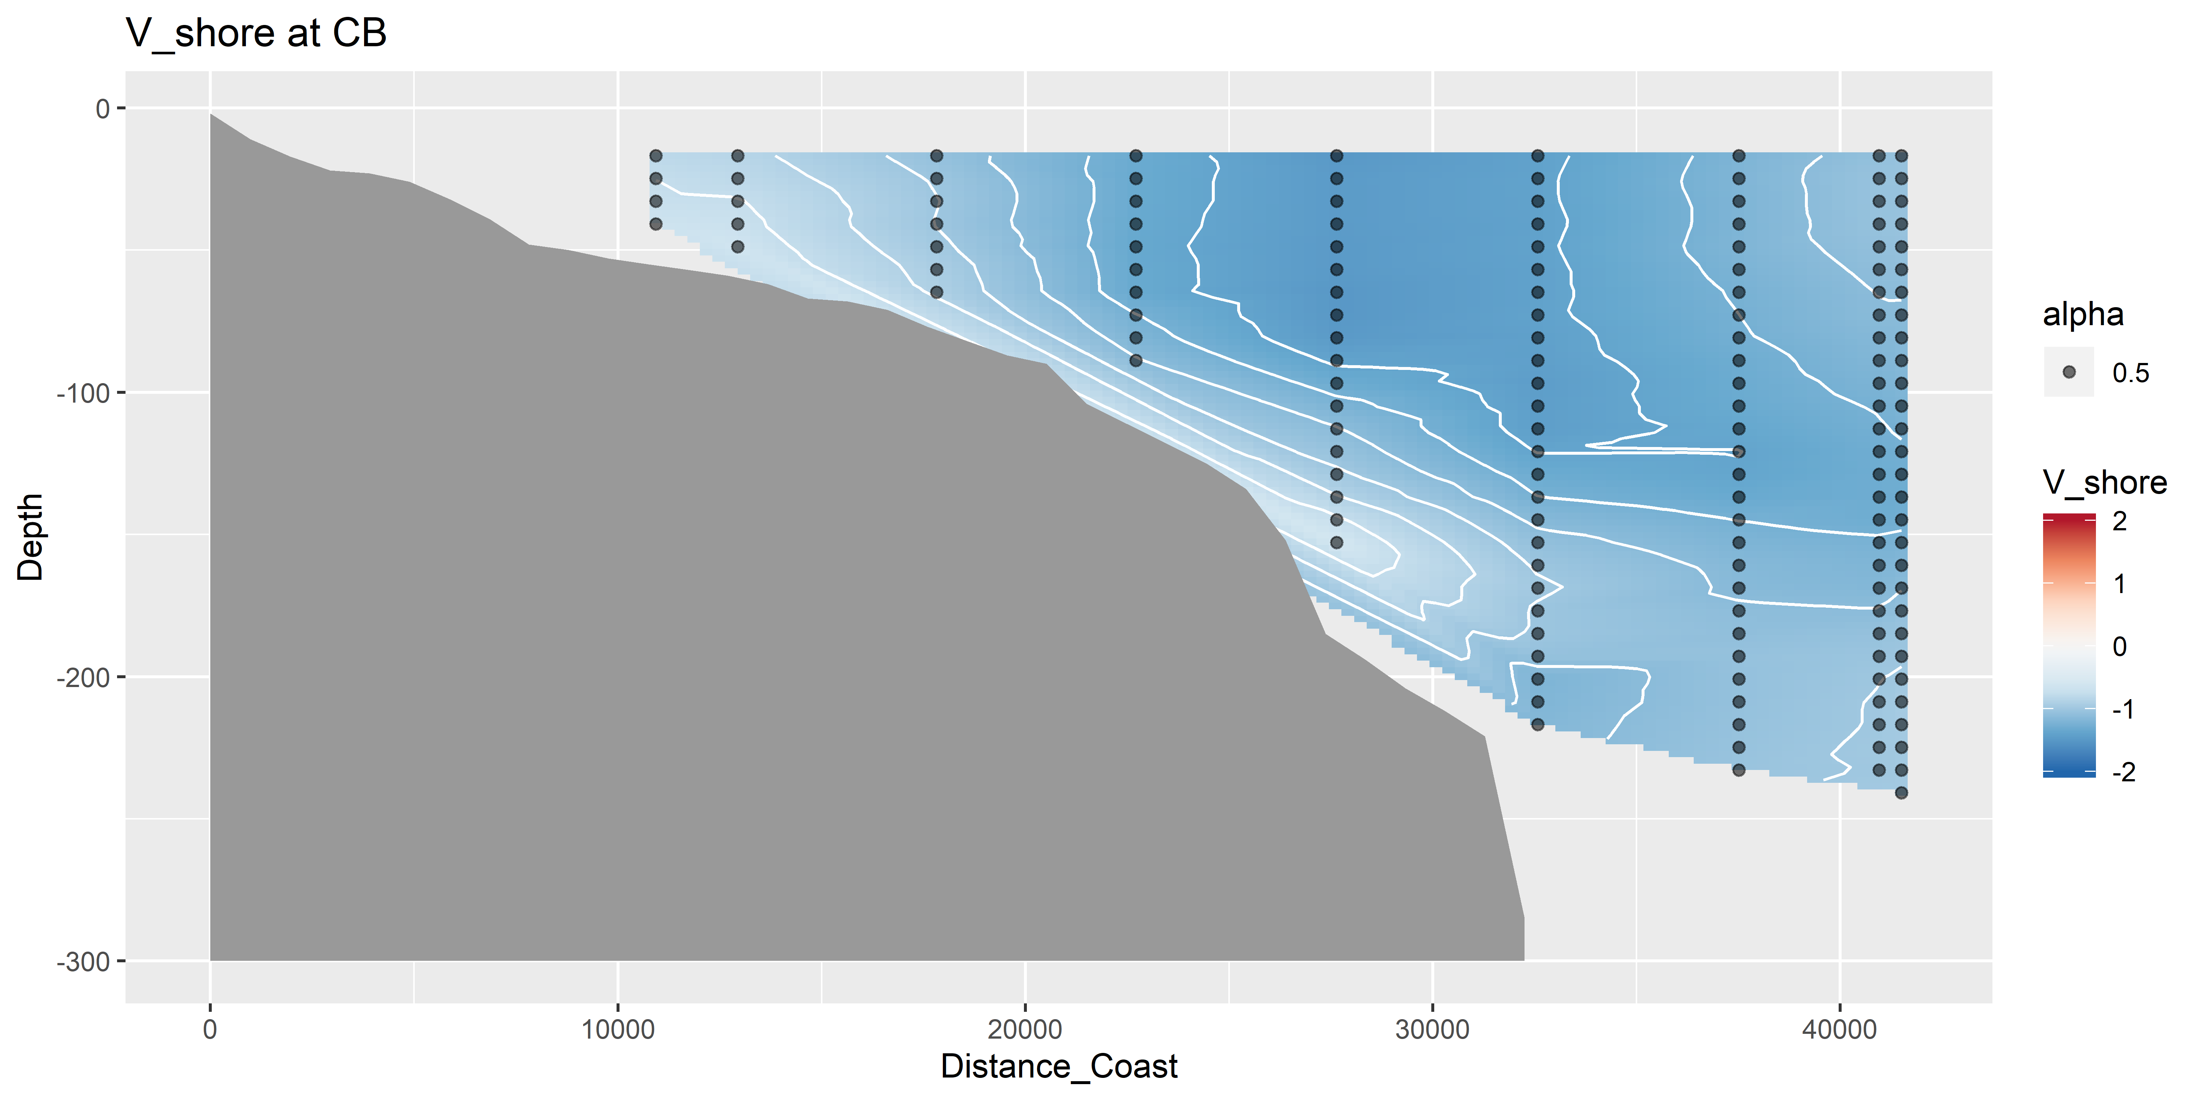
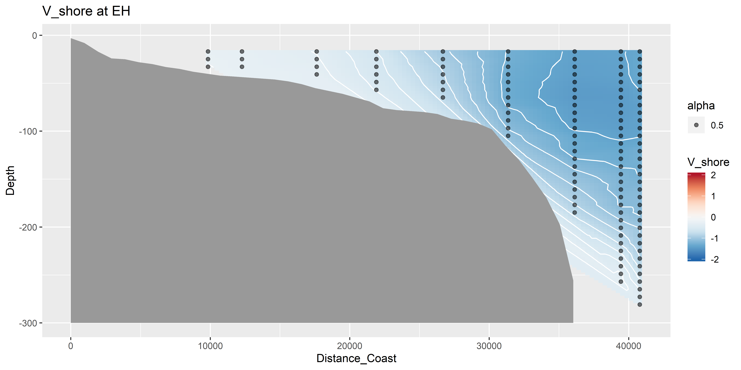
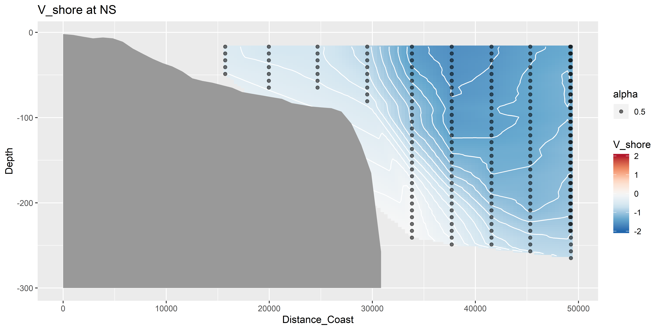
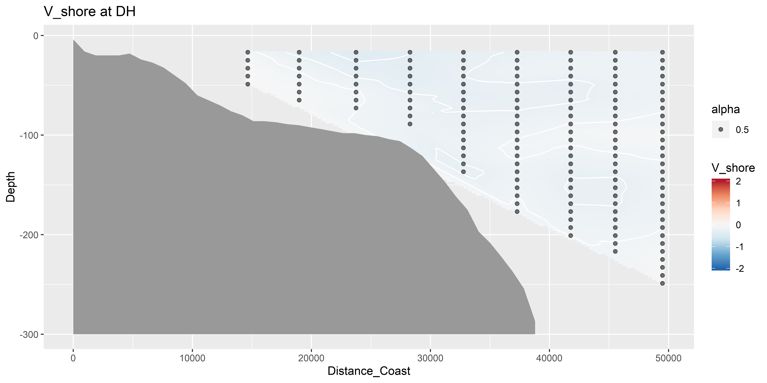
V vectors – shoreline rotated (m s⁻¹)

Slide 15
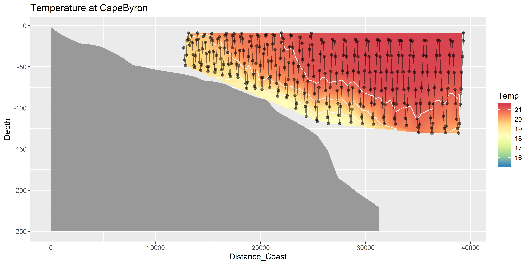
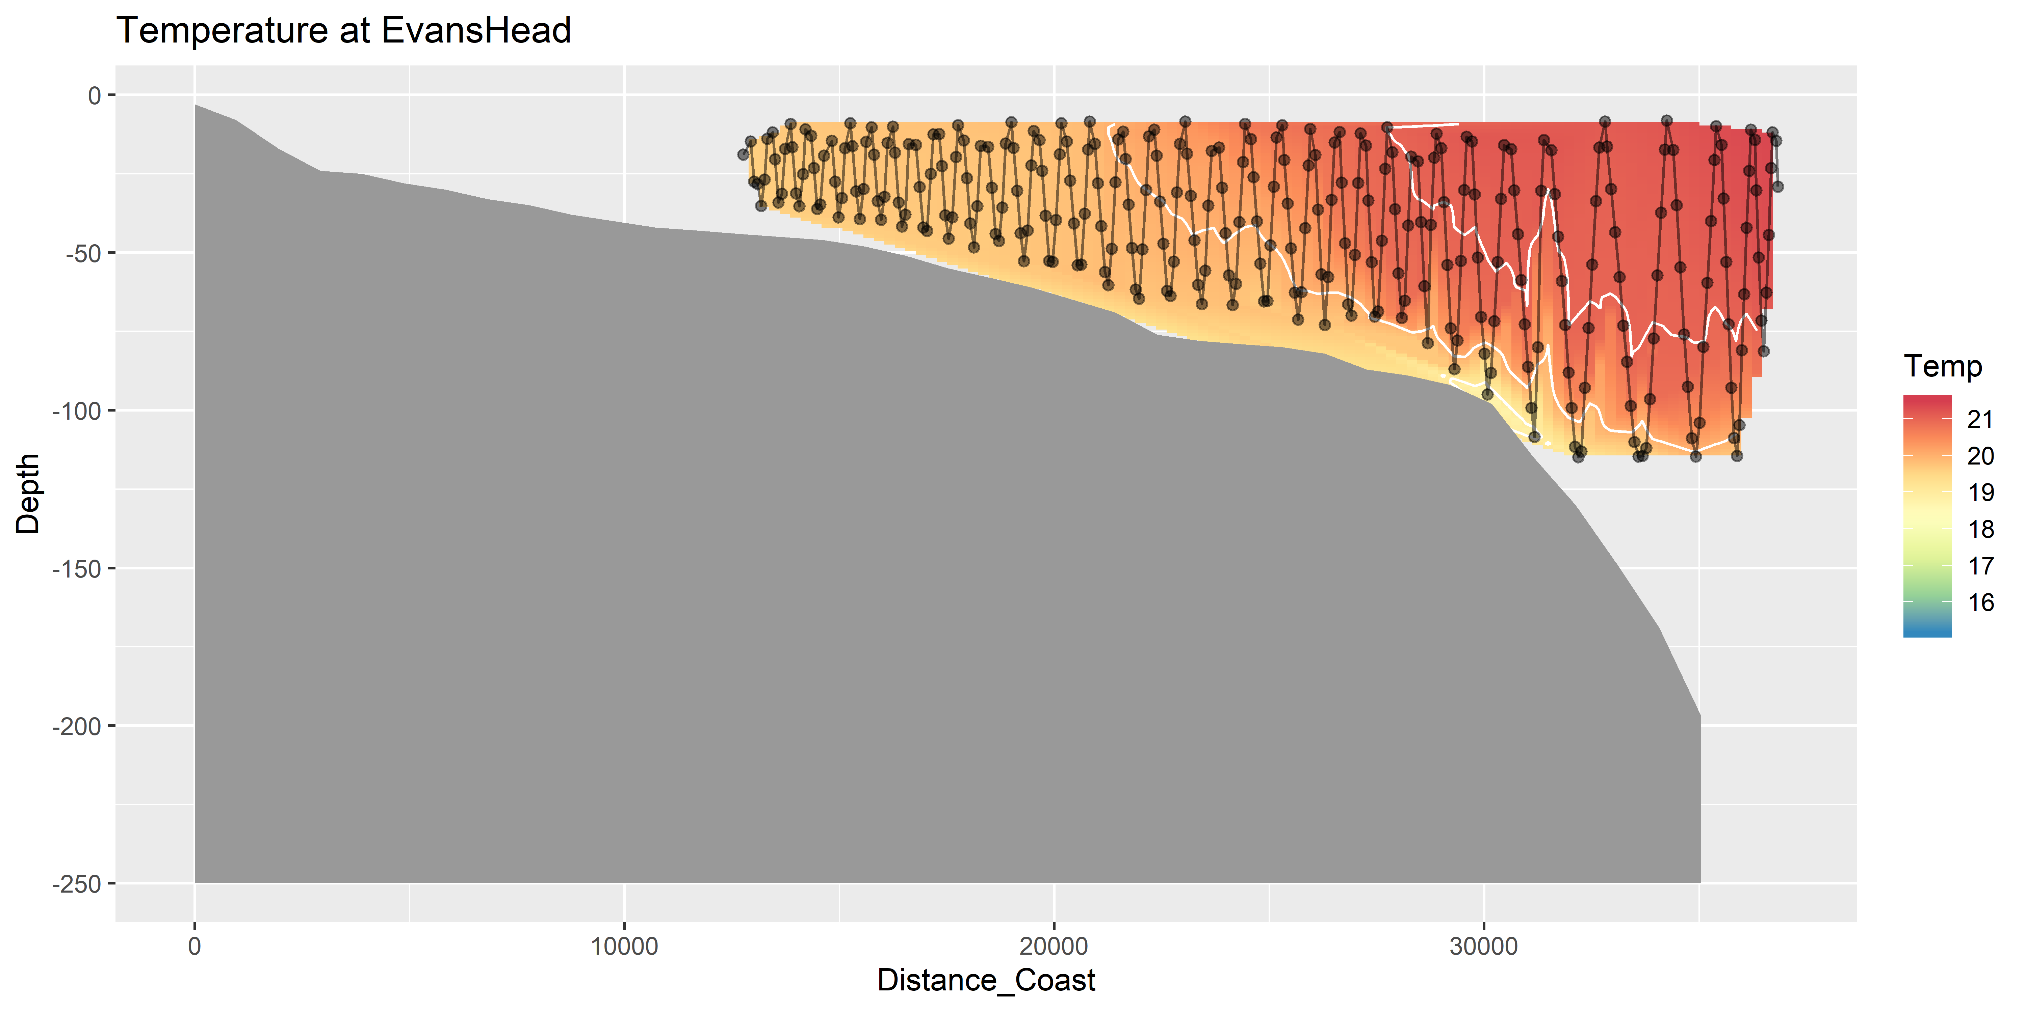
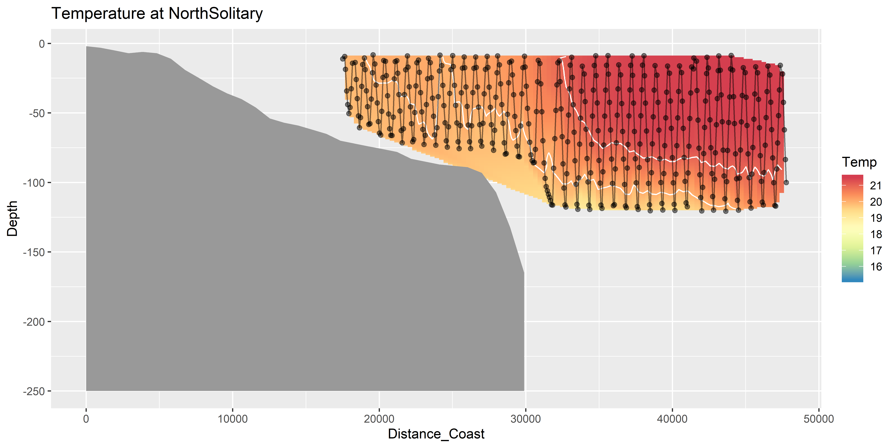
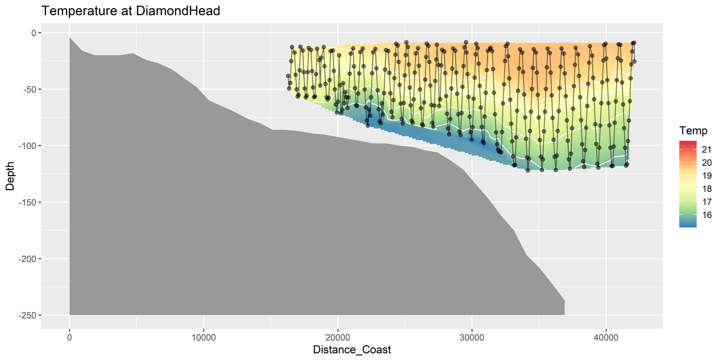
Temperature (seasoar)

Slide 16
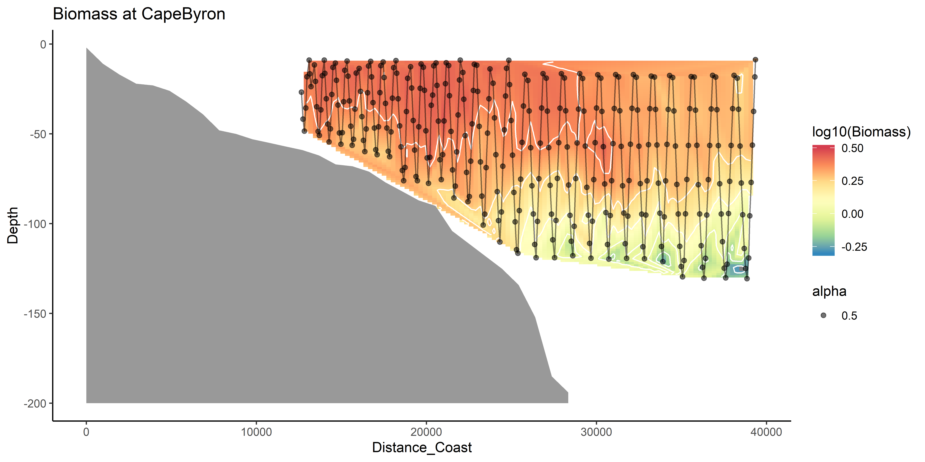
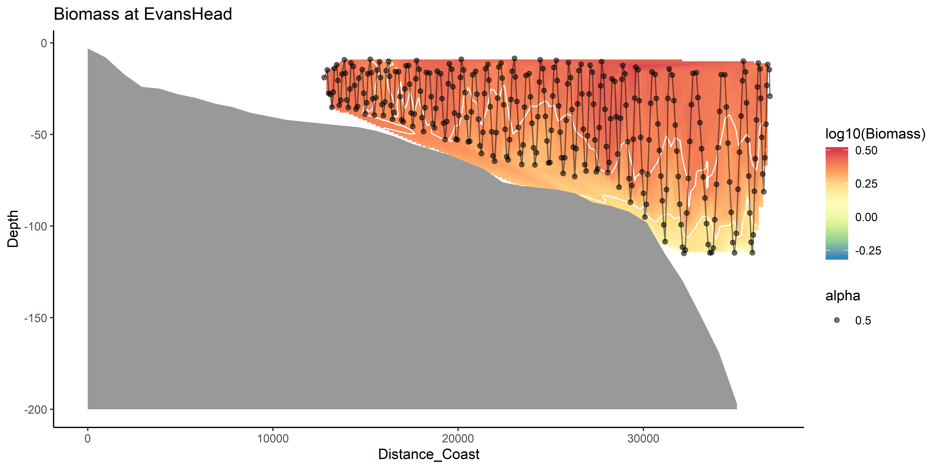
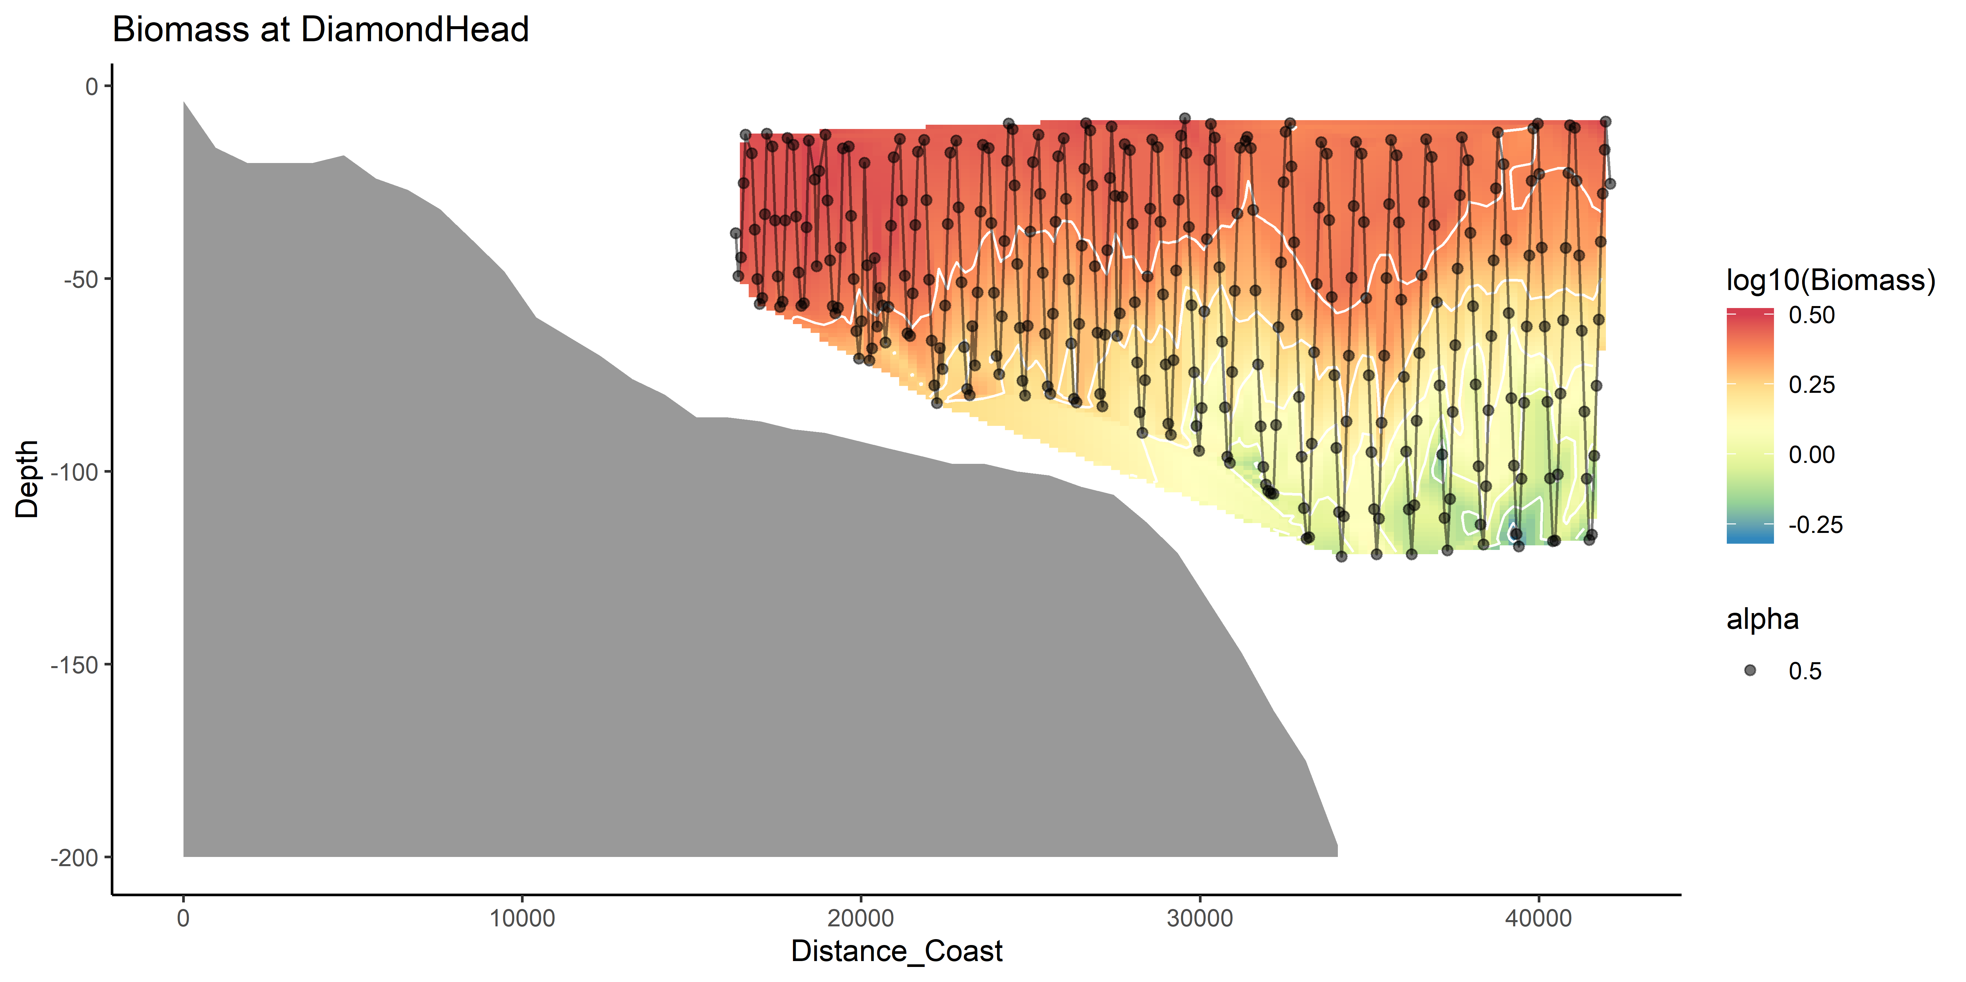
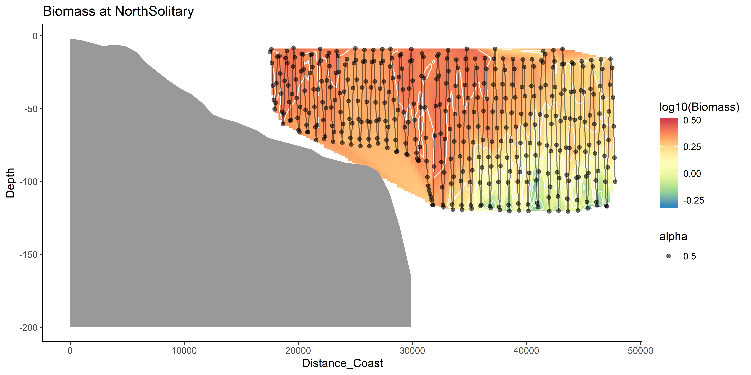
Zooplankton Biomass

Slide 17
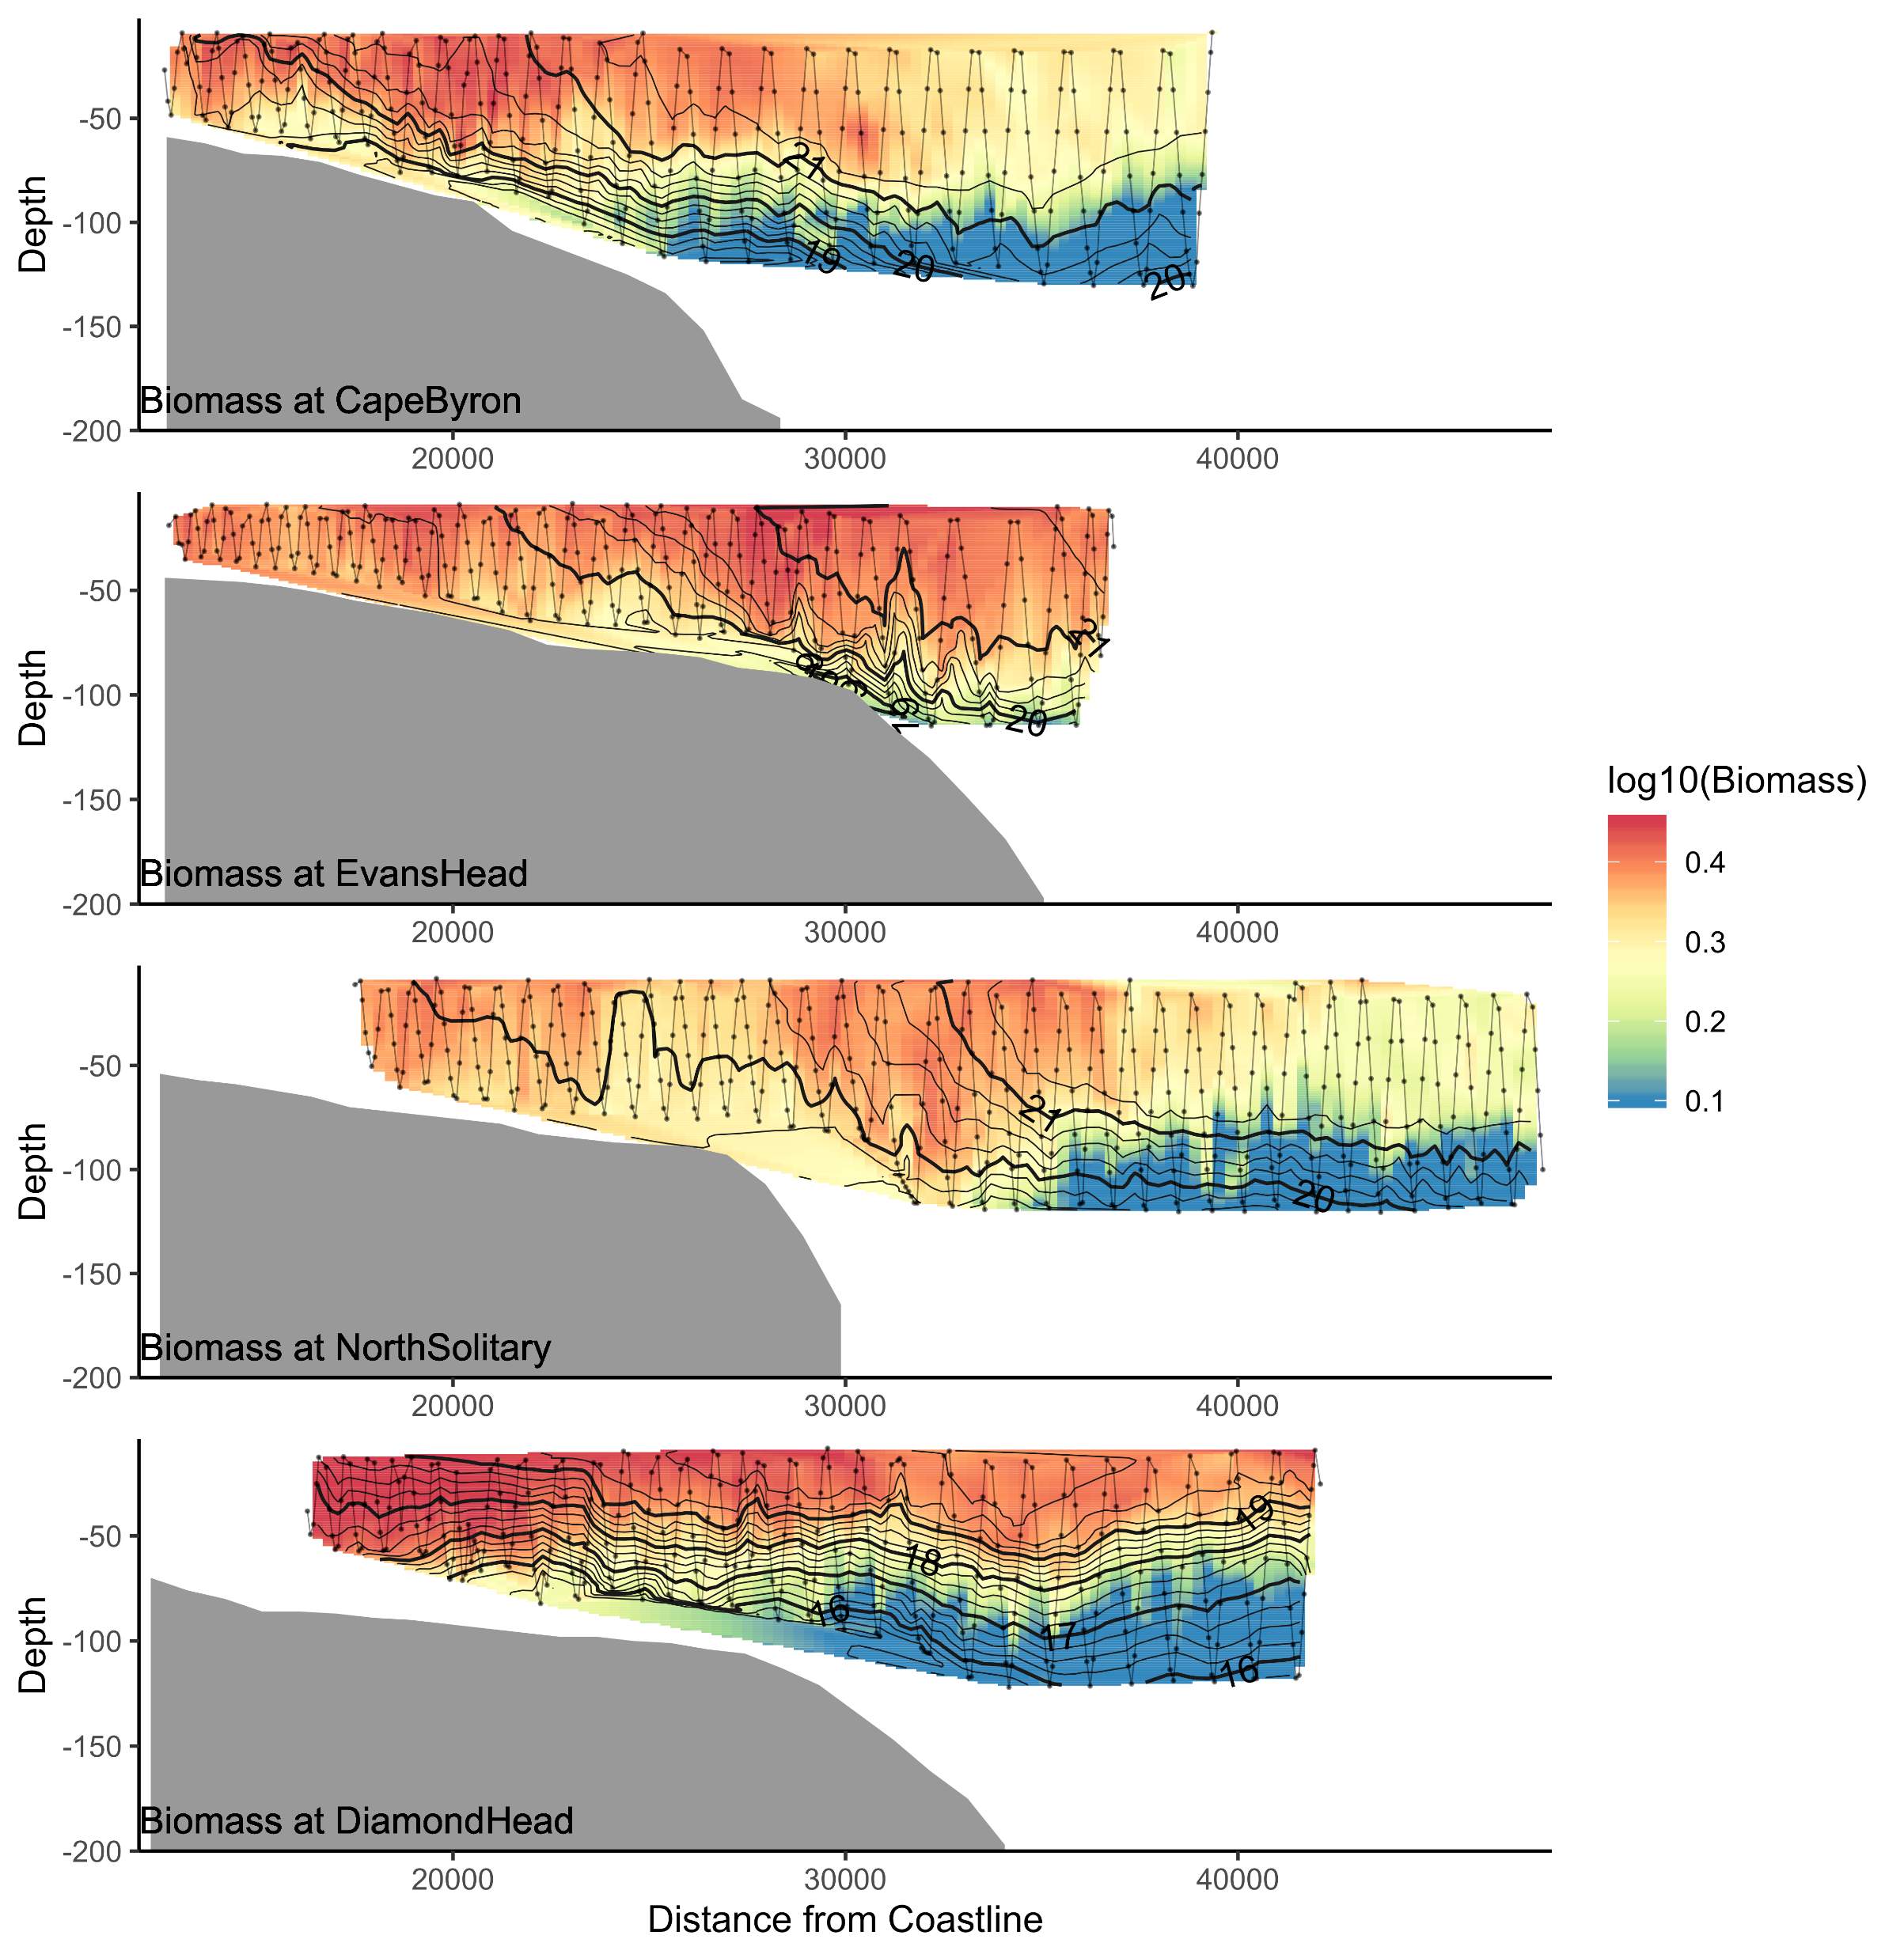
Biomass

Slide 18
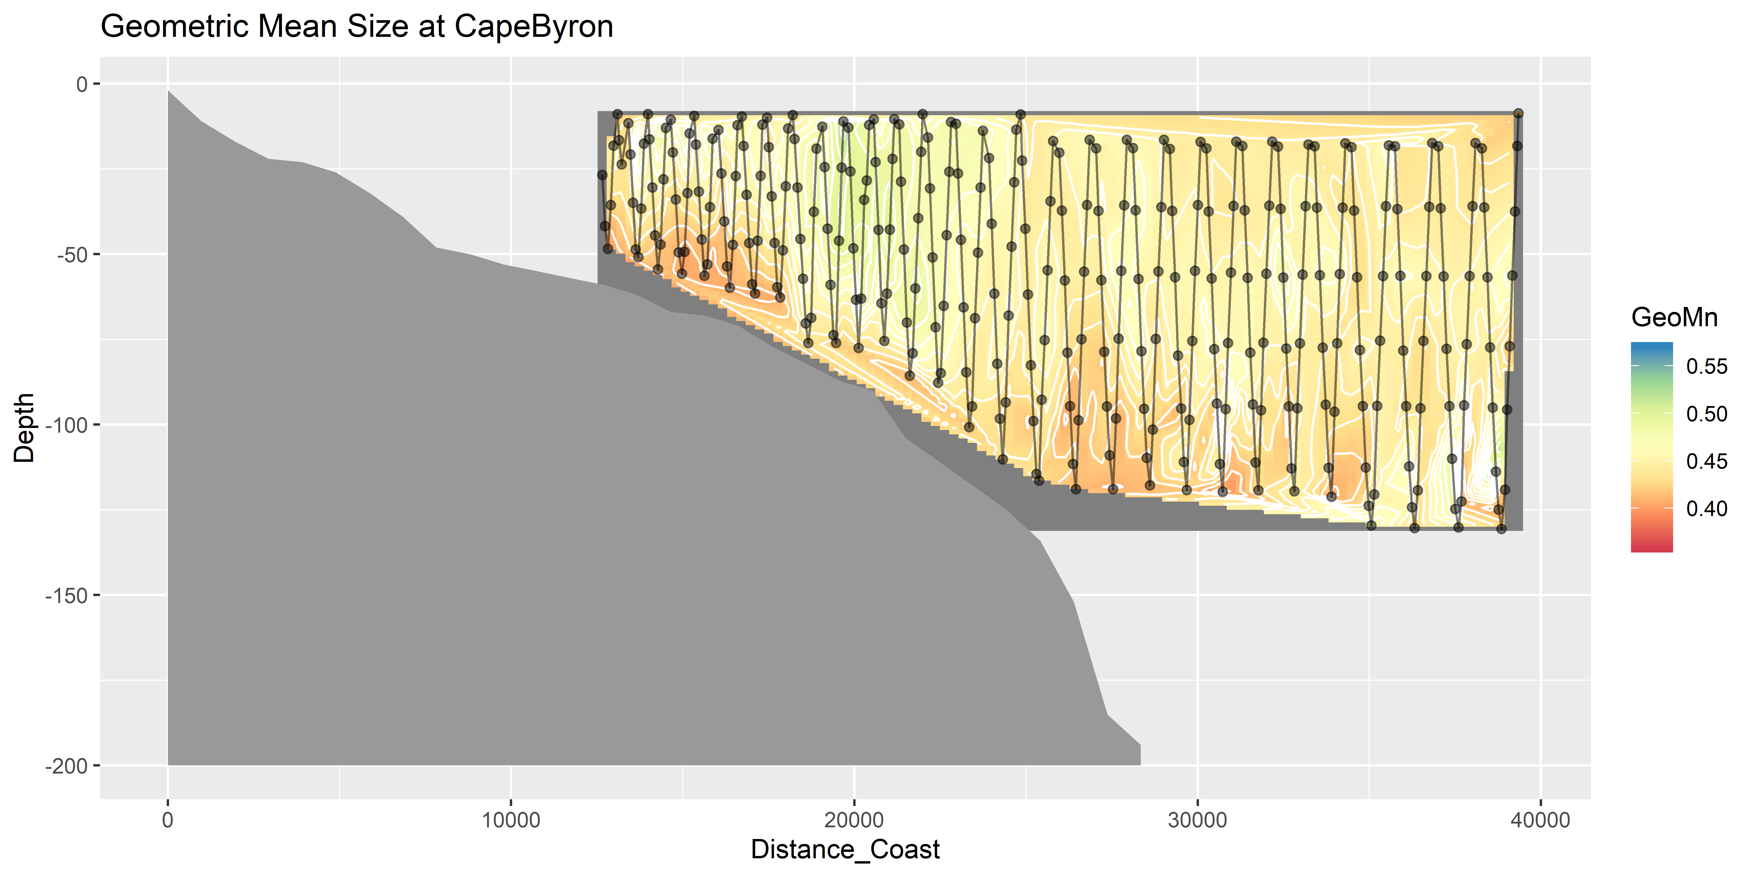
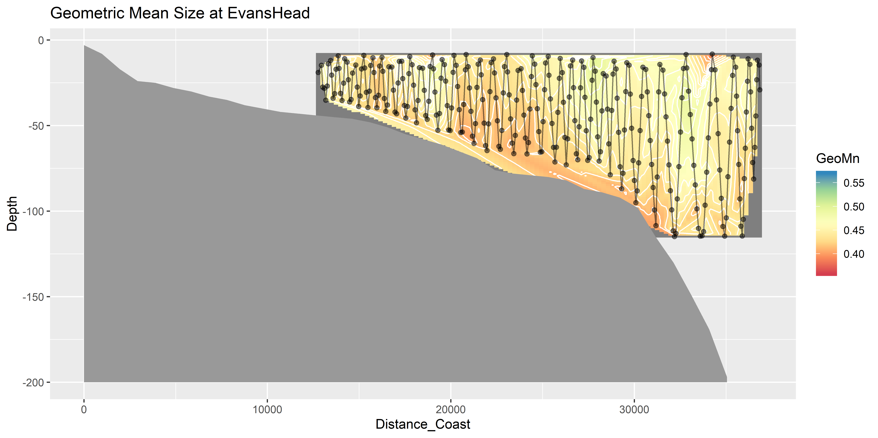
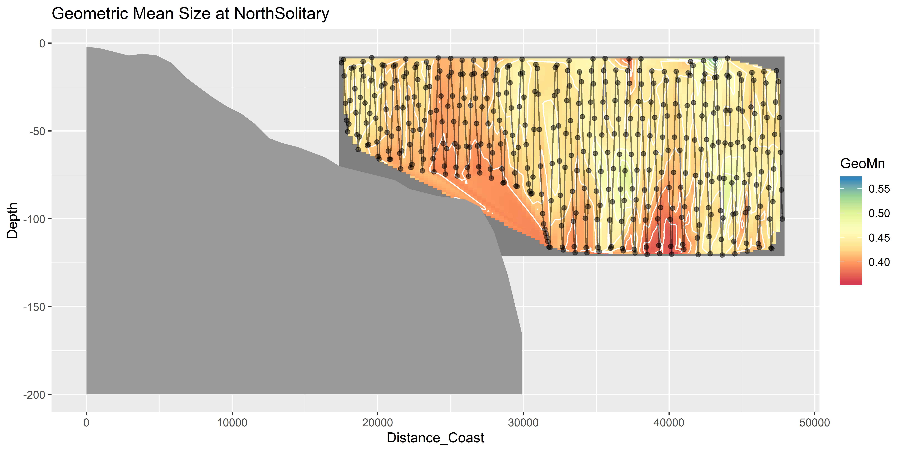
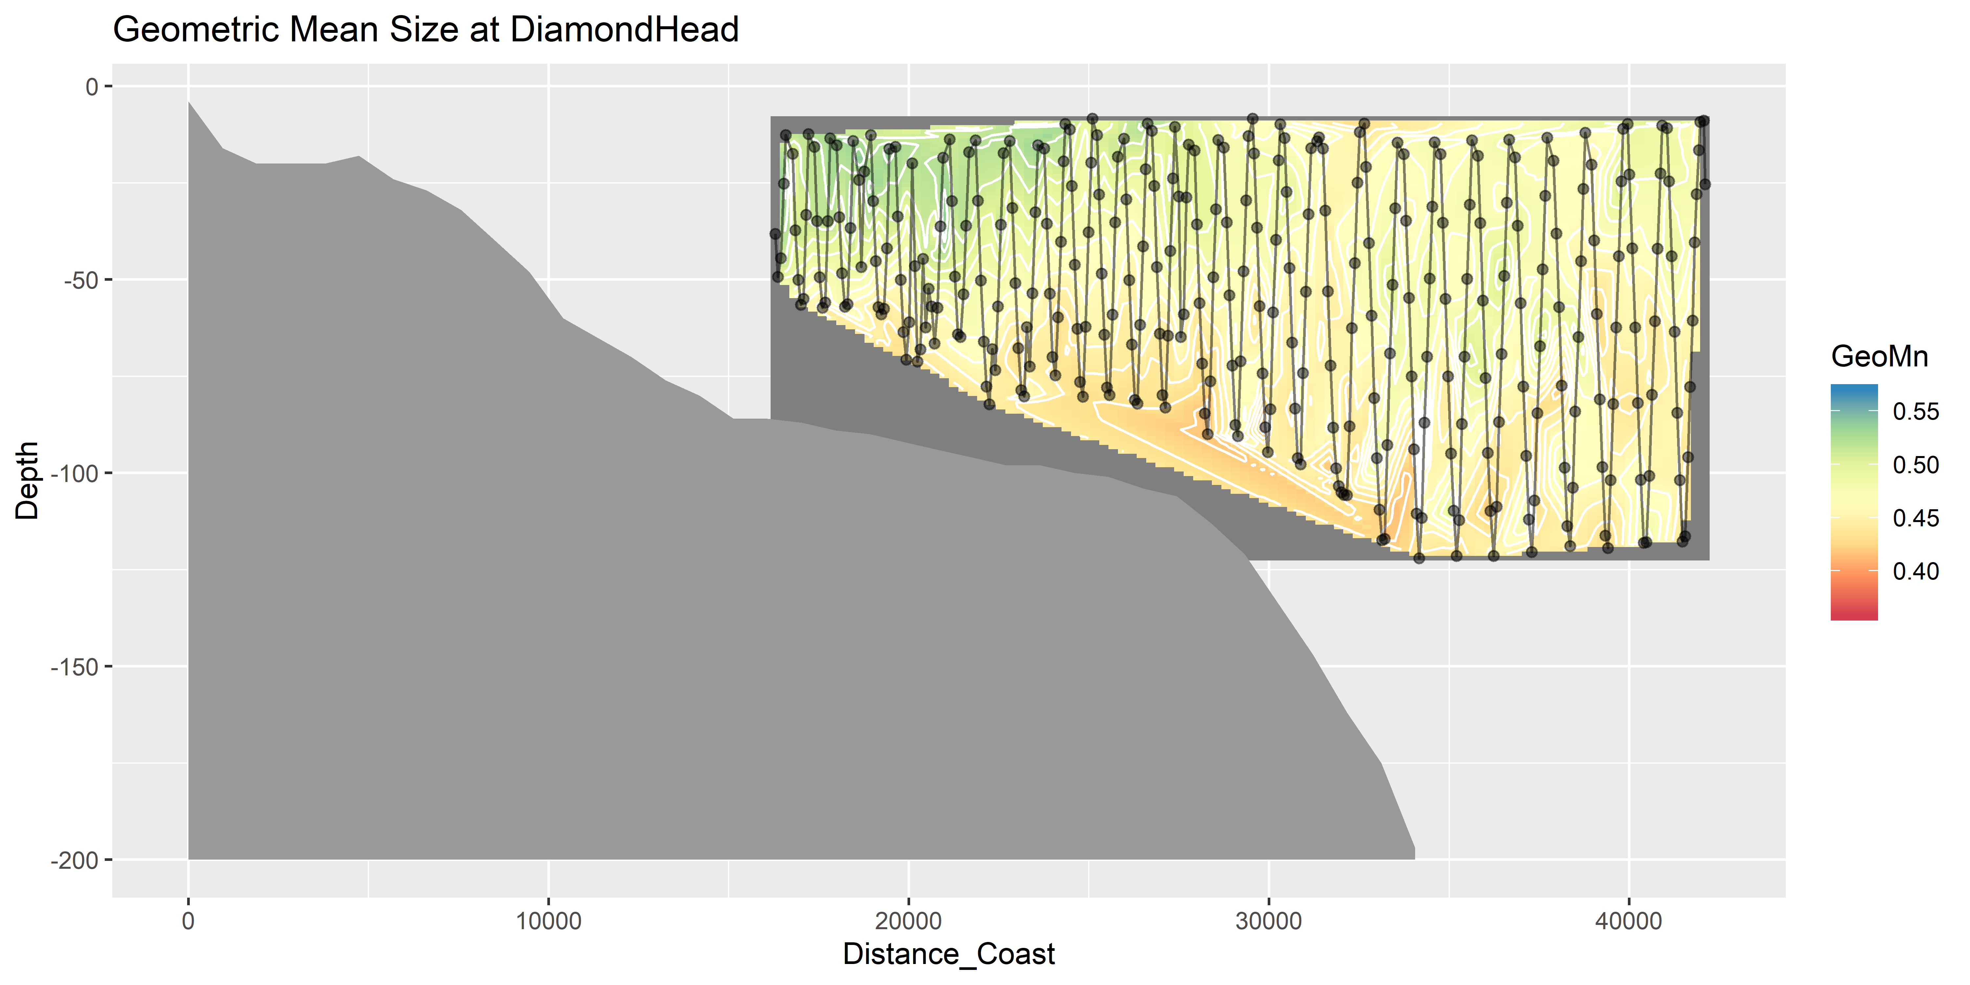
Geometric Mean Size

Slide 19
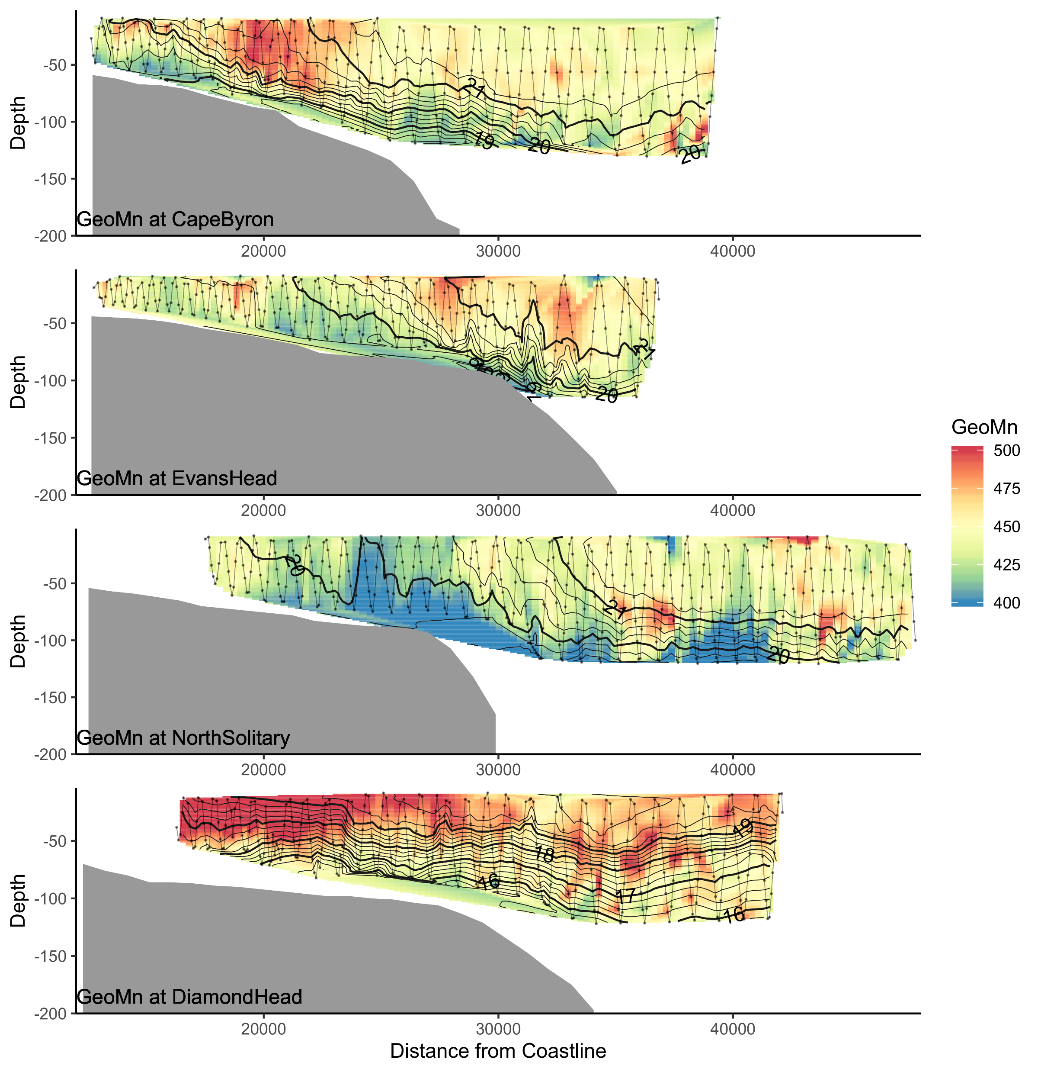
Geo Mean Size

Slide 20
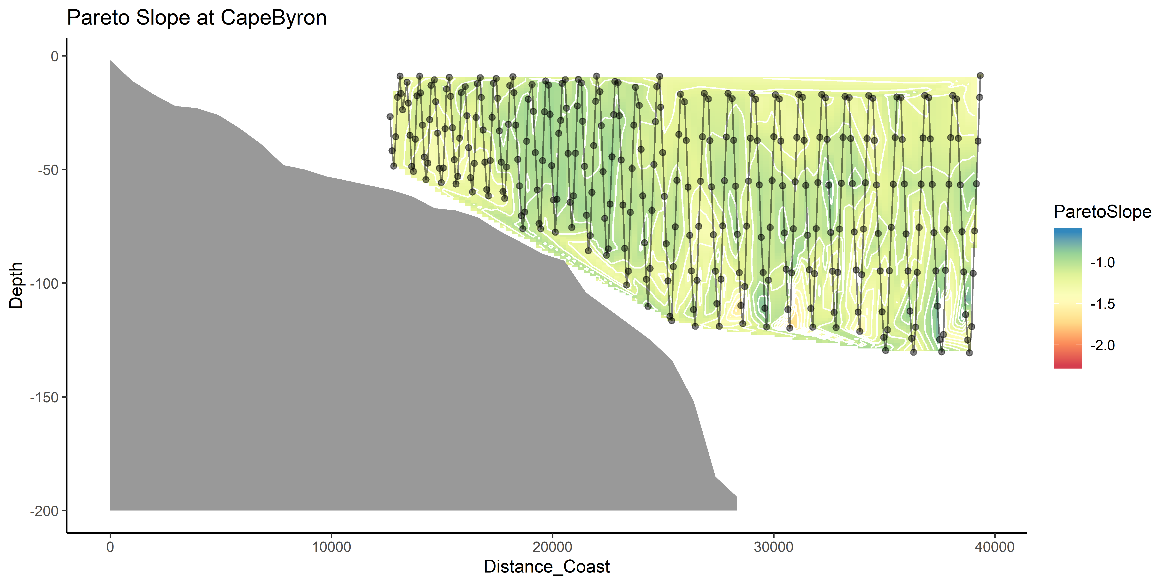
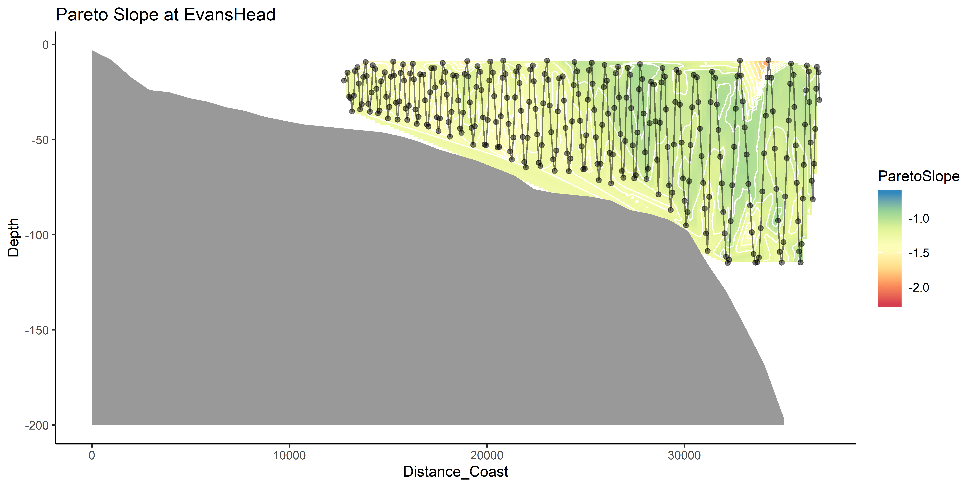
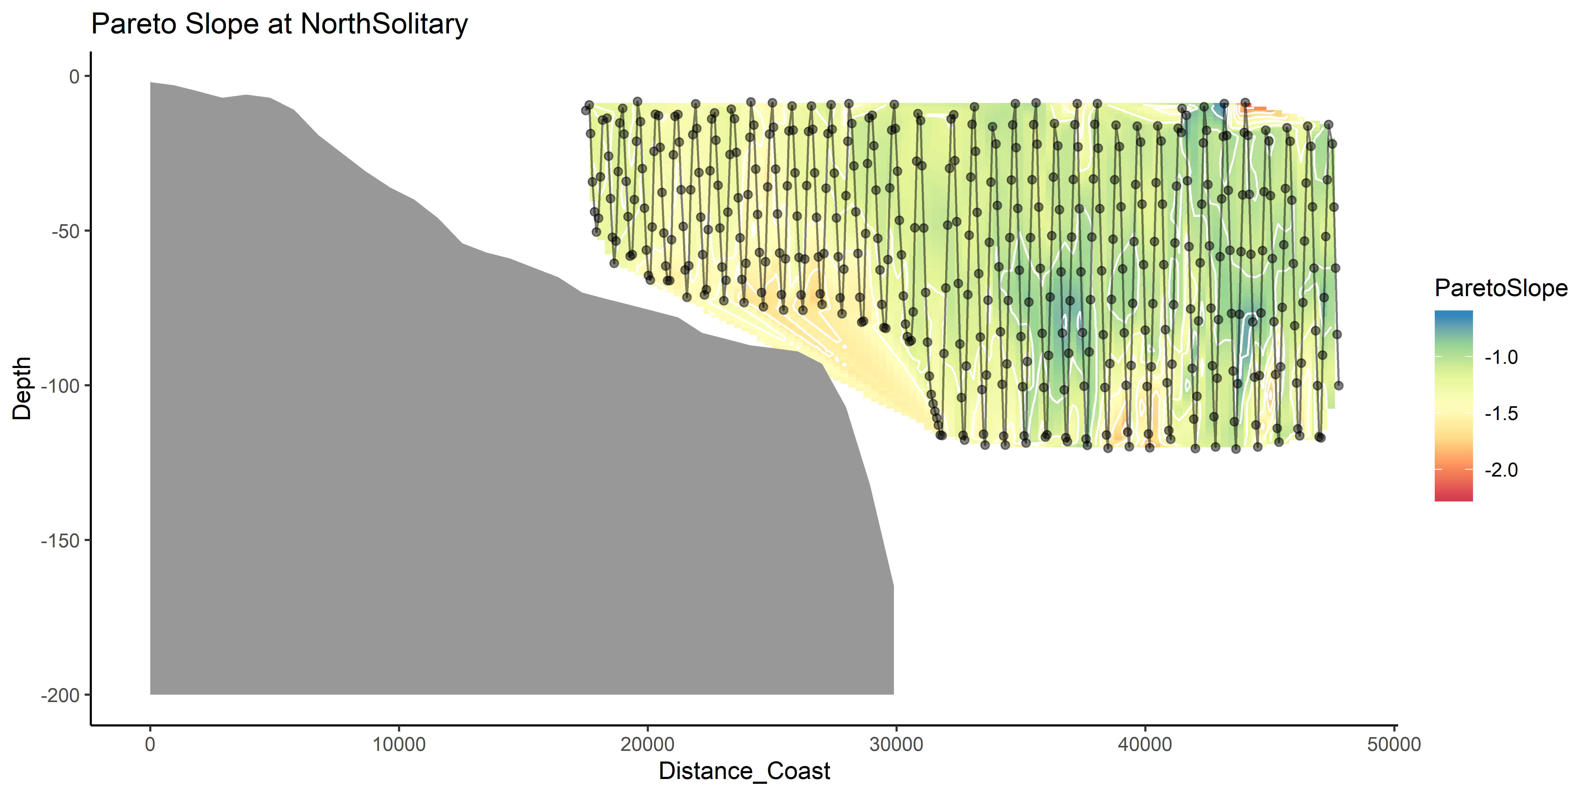
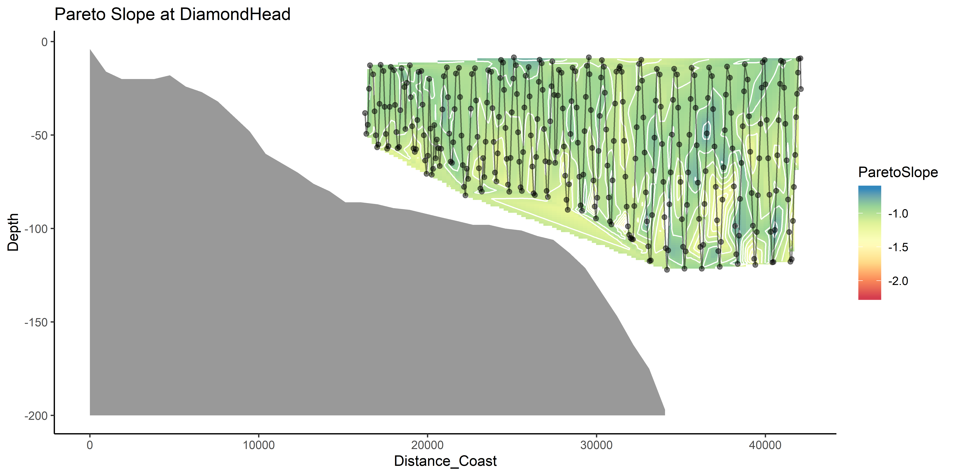
Pareto Slope

Slide 21
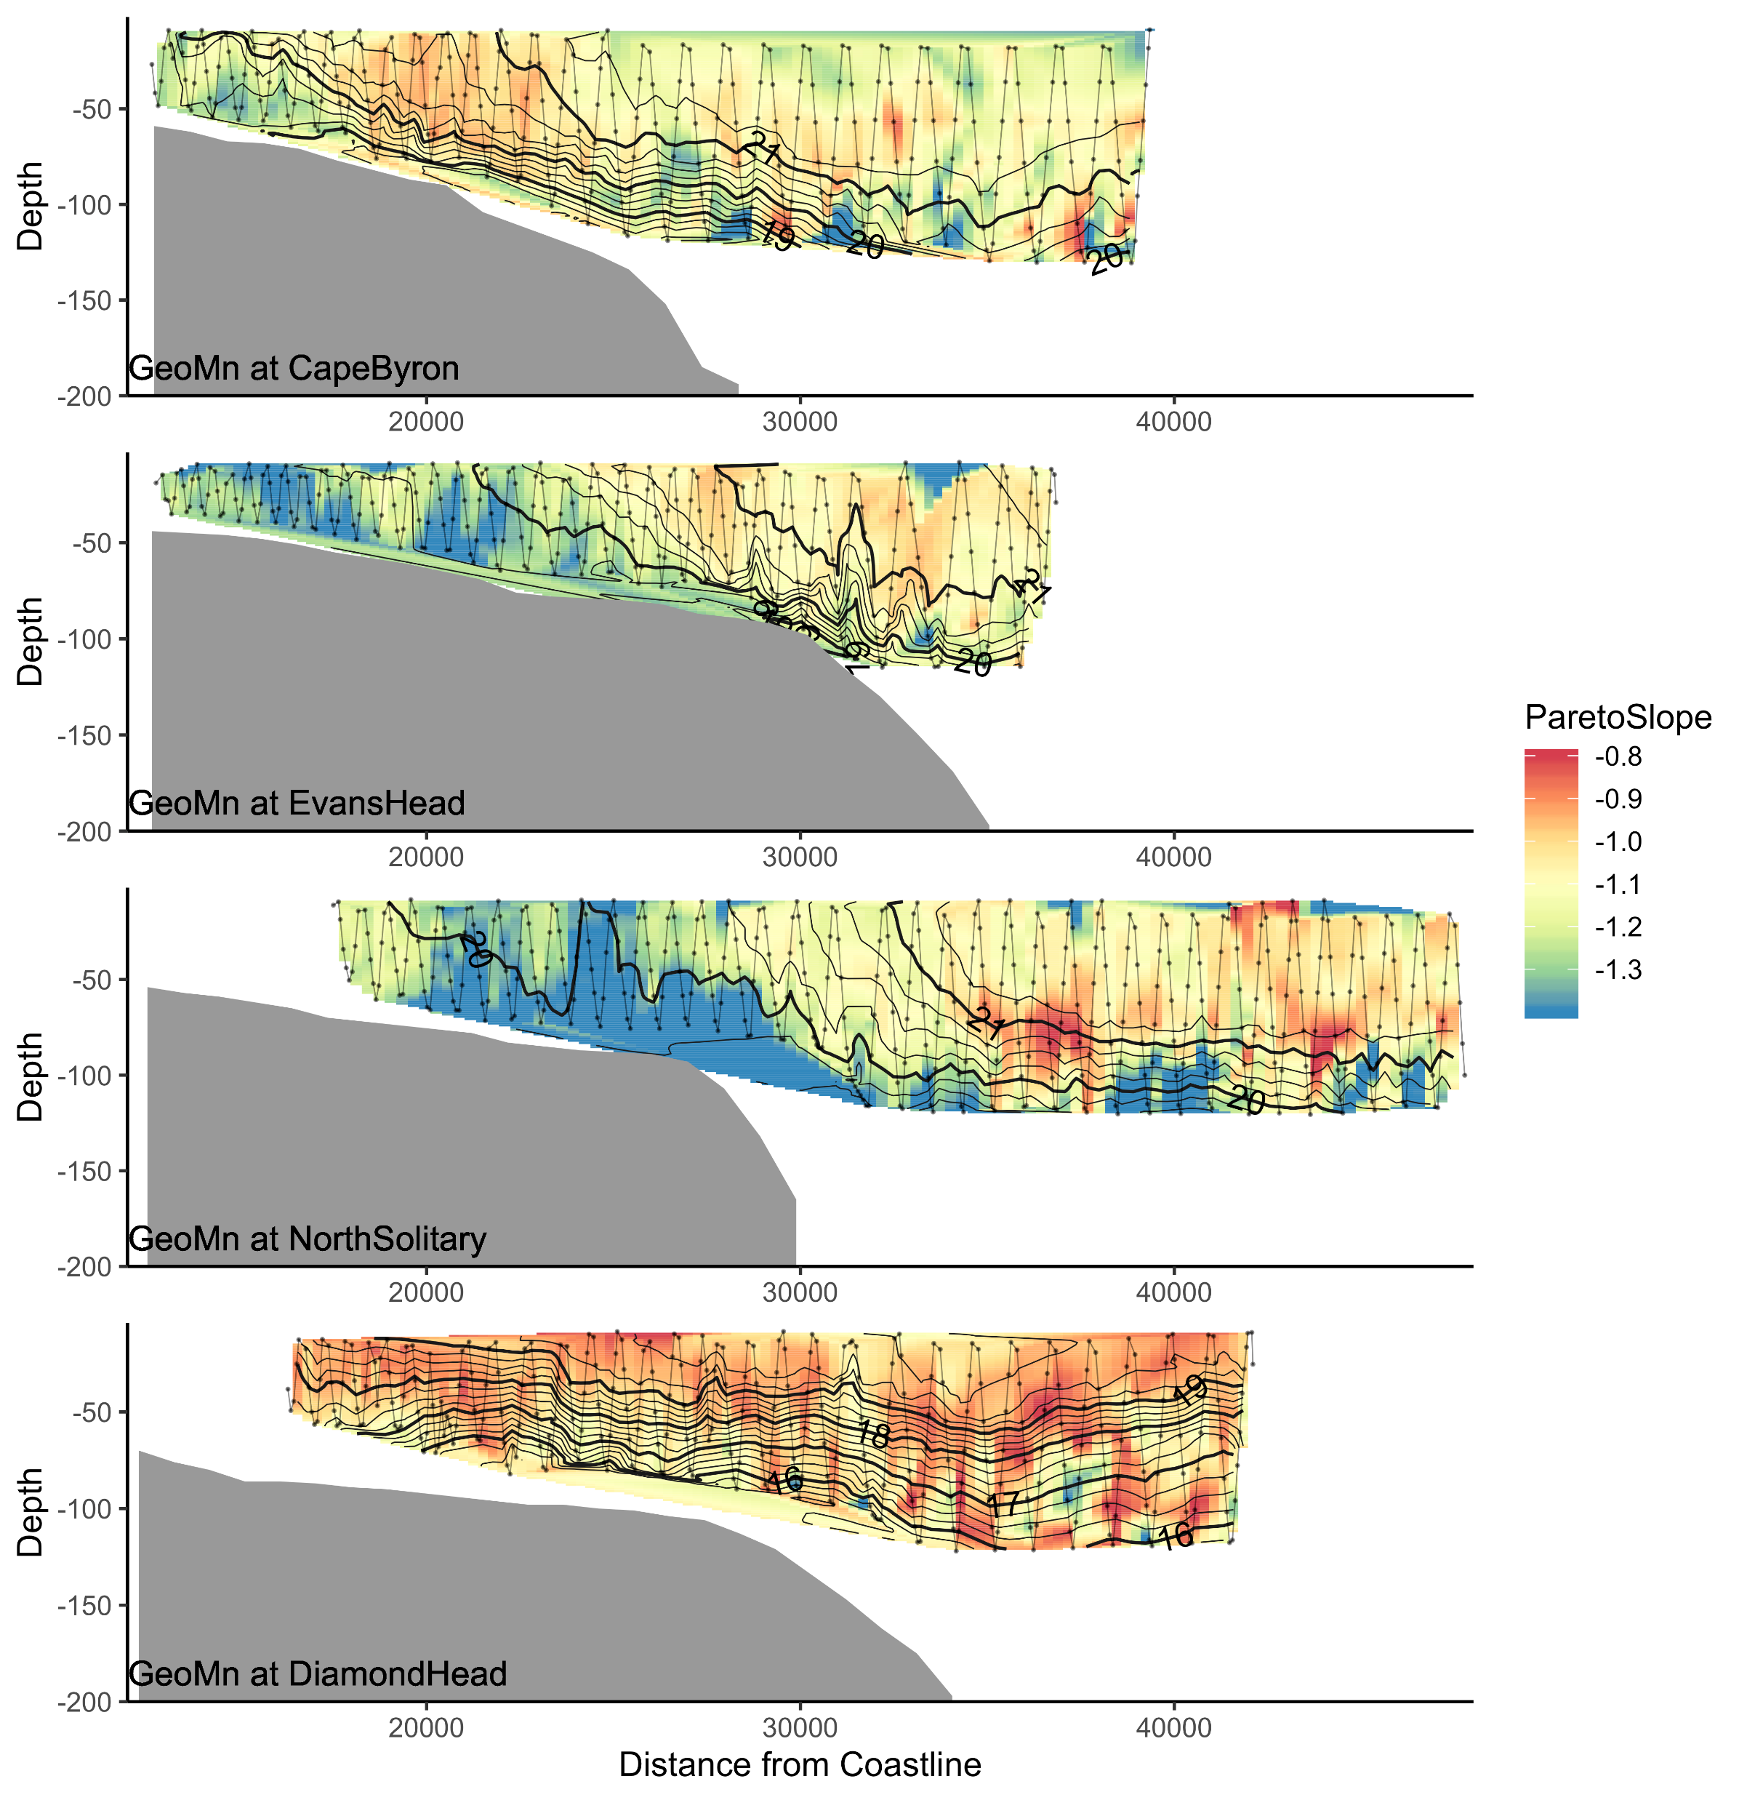
Pareto Slope

Slide 22
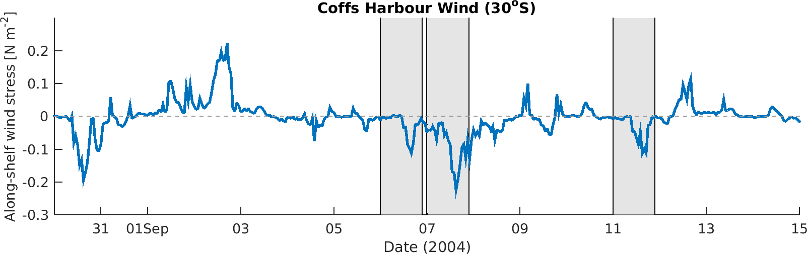
Wind Stress
DH
EH
CB

Slide 23
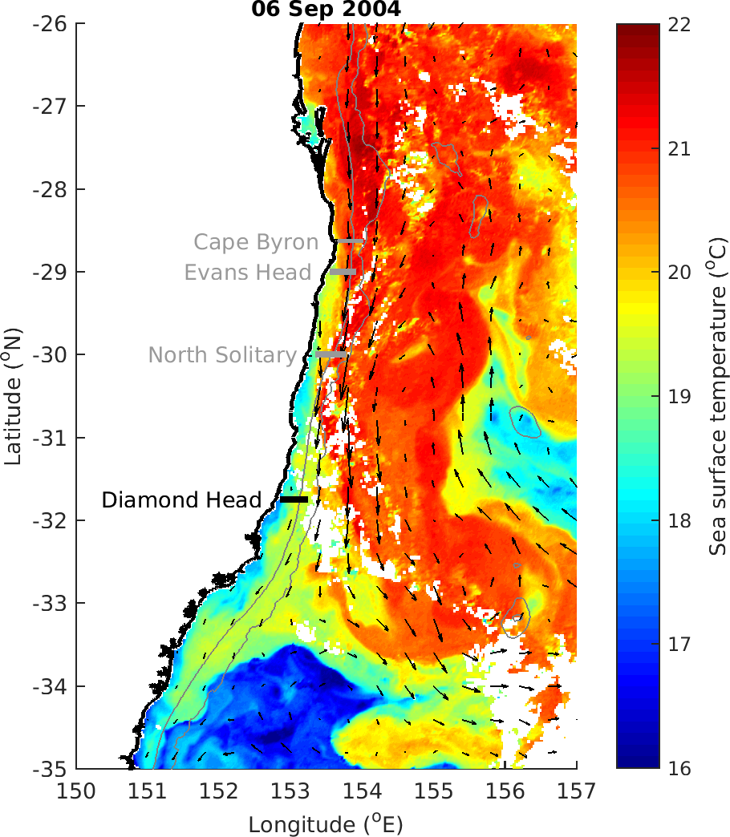

Slide 24
Zooplankton Characteristics
Biomass decreases with depth and distance from shore
Does size vary between the EAC water masses and separation zone?
Largest particles near shore at Diamond Head, due to separation and different water?
Slope does not appear to consistently approach -1 in offshore water (theoretical expectation)
Vandromme showed shallower slope offshore (-1 → -0.4; SW France)

Slide 26
OLDER STUFF

Slide 27
Linking water and zooplankton
Temp + Salt highly correlated (0.93)
Temp + Depth slight neg. cor. (-0.3)
Temp + Distance_Coast slight pos. cor (0.24)
Longitude + Distance_Coast slight pos. cor (0.09)
Moran’s I value = 0.33 (Biomass)
Moran’s I value = 0.29 (Pareto Slope)

Slide 28
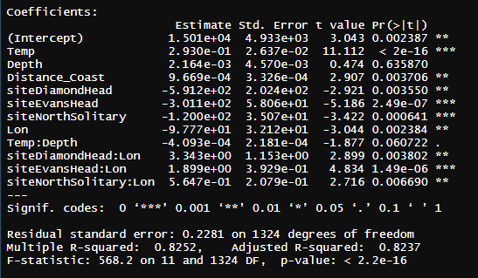
Zooplankton Biomass models
log10(Biomass) ~ Temp * Depth + Distance_Coast + site * Lon, data = mydataX)

Slide 29
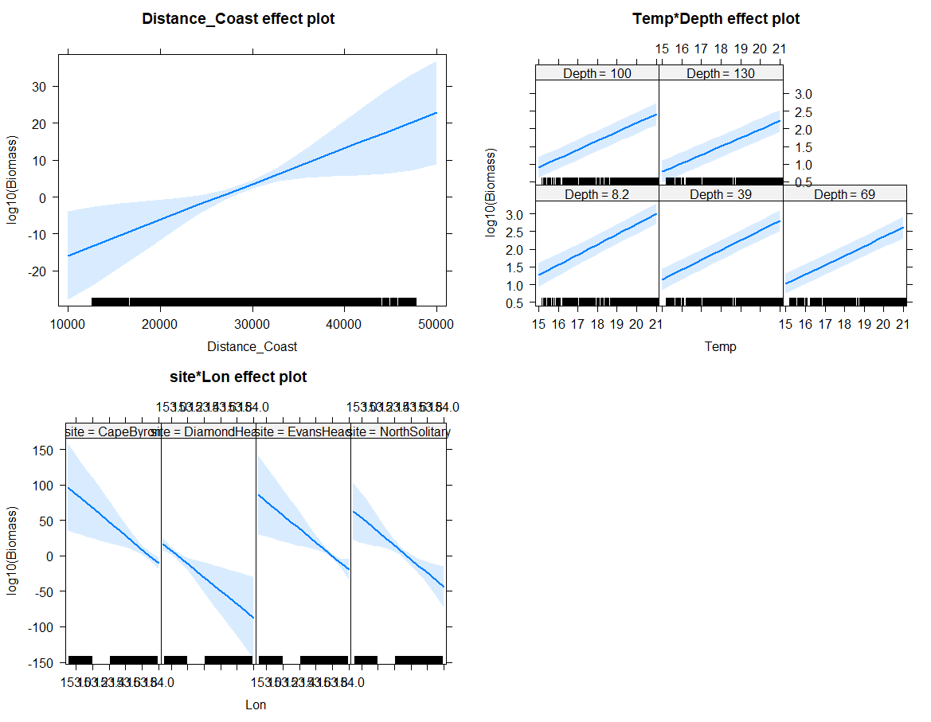

Slide 30
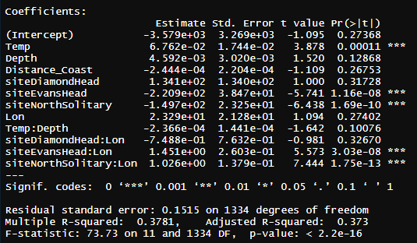
Pareto Slope Model
ParetoSlope ~ Temp * Depth + Distance_Coast + site * Lon

Slide 31
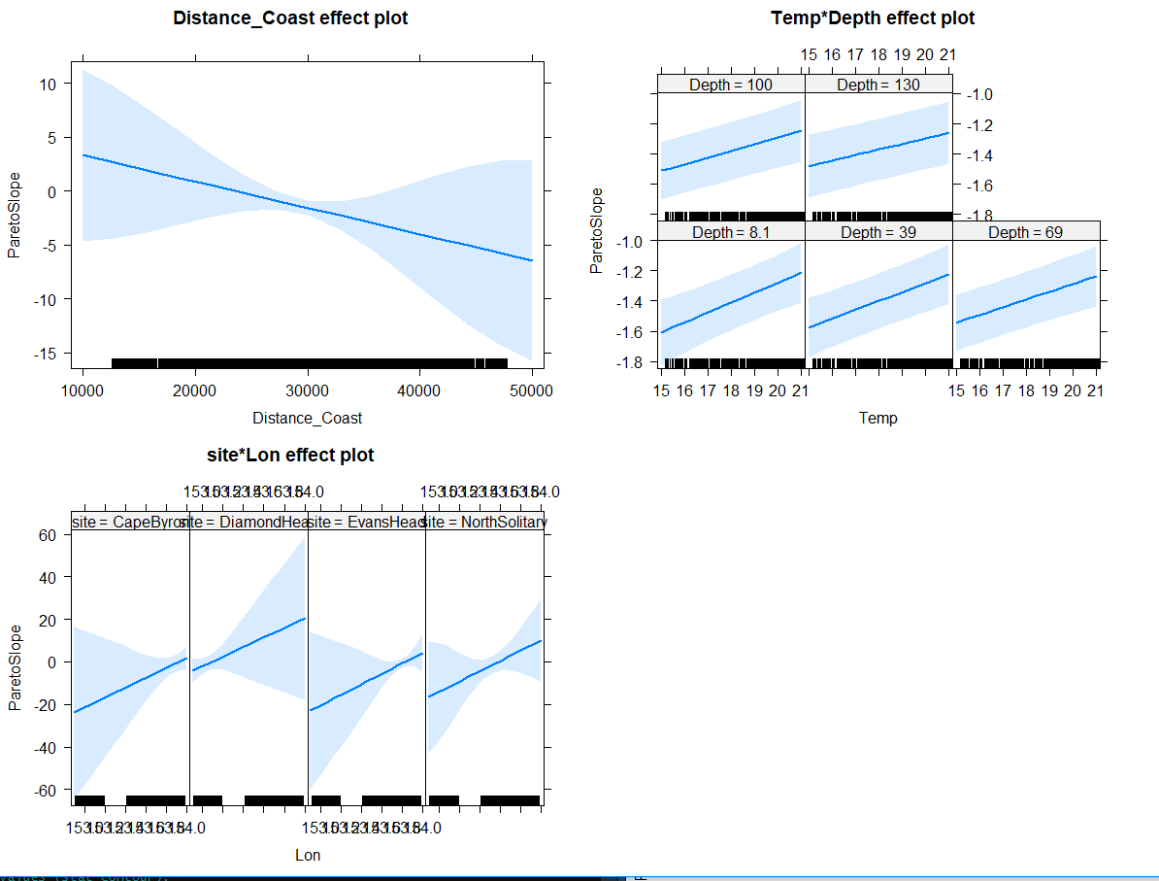

Slide 32
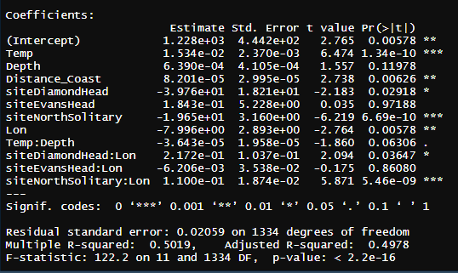
GeoMn Size
GeoMn*1000 ~ Temp * Depth + Distance_Coast + site * Lon, data = mydata

Slide 33
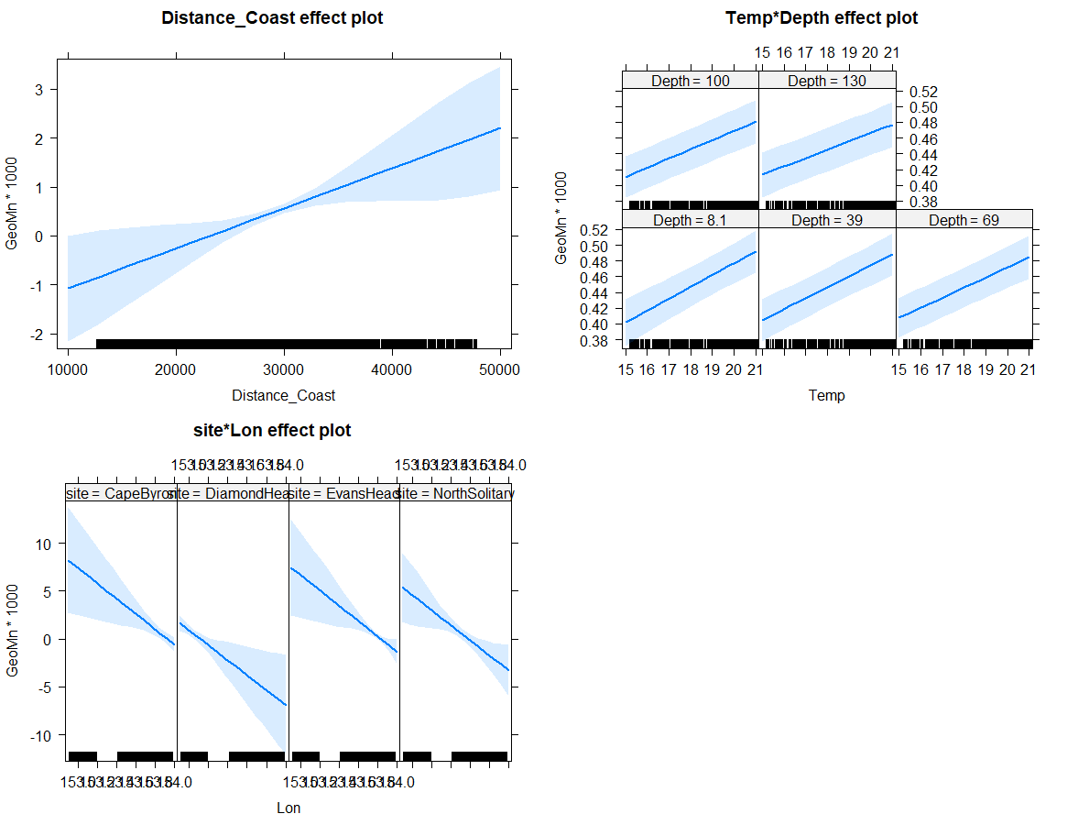

Slide 34
Larger context (not for today)
How typical are the observations seen in these transects?
Temp and Sal
Chl-a
IMOS NRS Moorings
Gliders
Satellite data

Slide 36
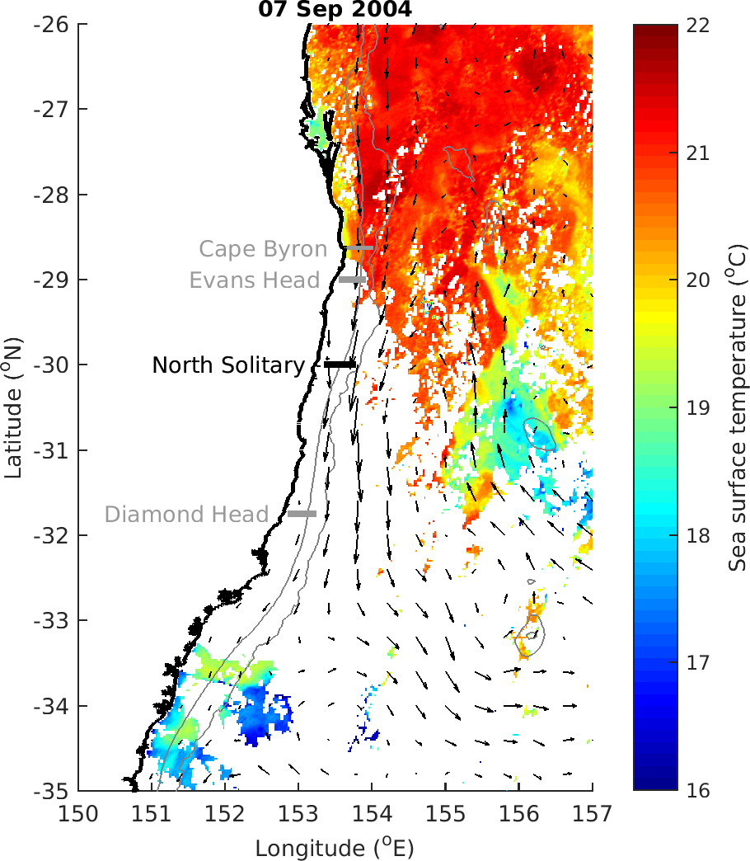

Slide 37
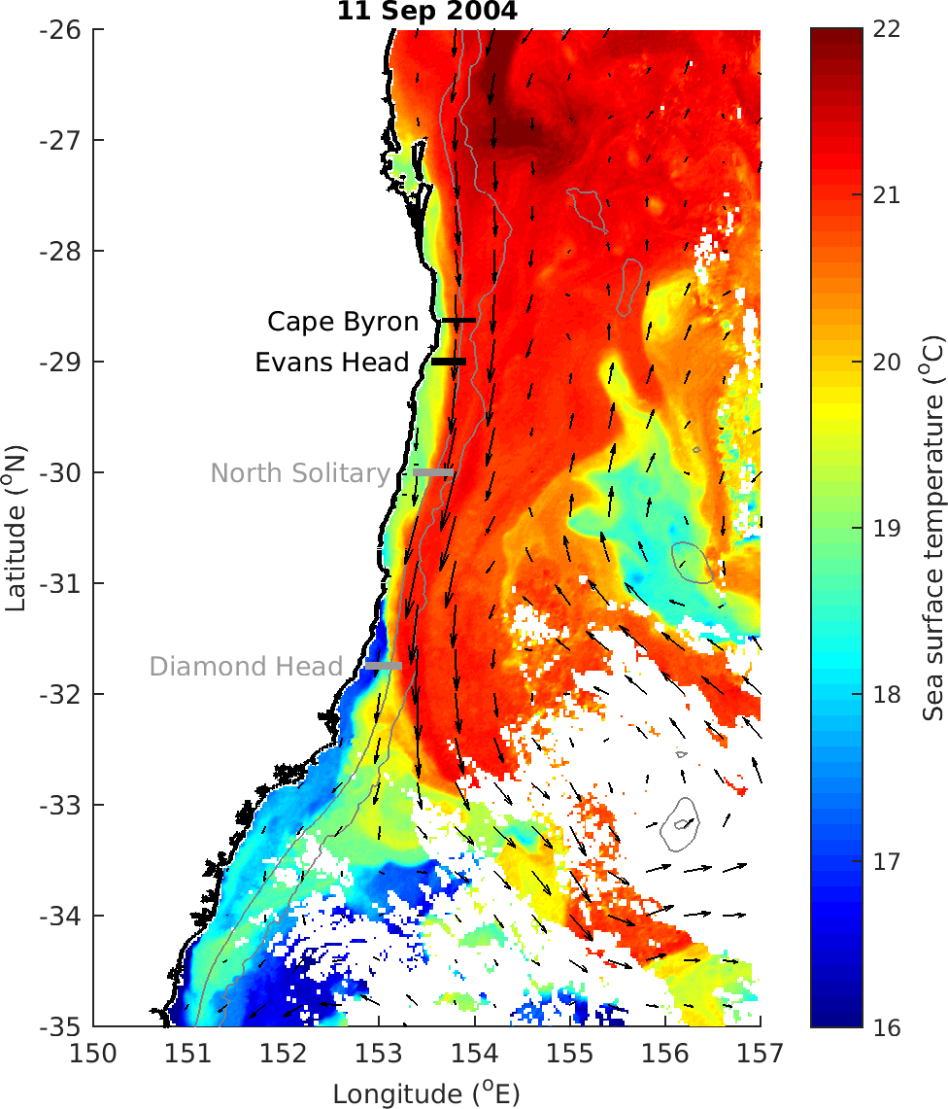

Slide 38
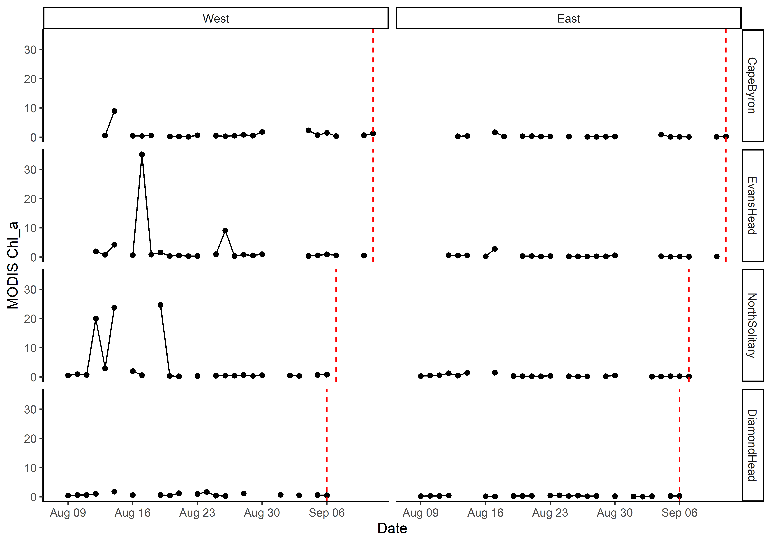
MODIS Chl_a

Slide 39
T-S Plot all depths (CTD)

Slide 40
TS Plot by log₁₀(Biomass)

Slide 41
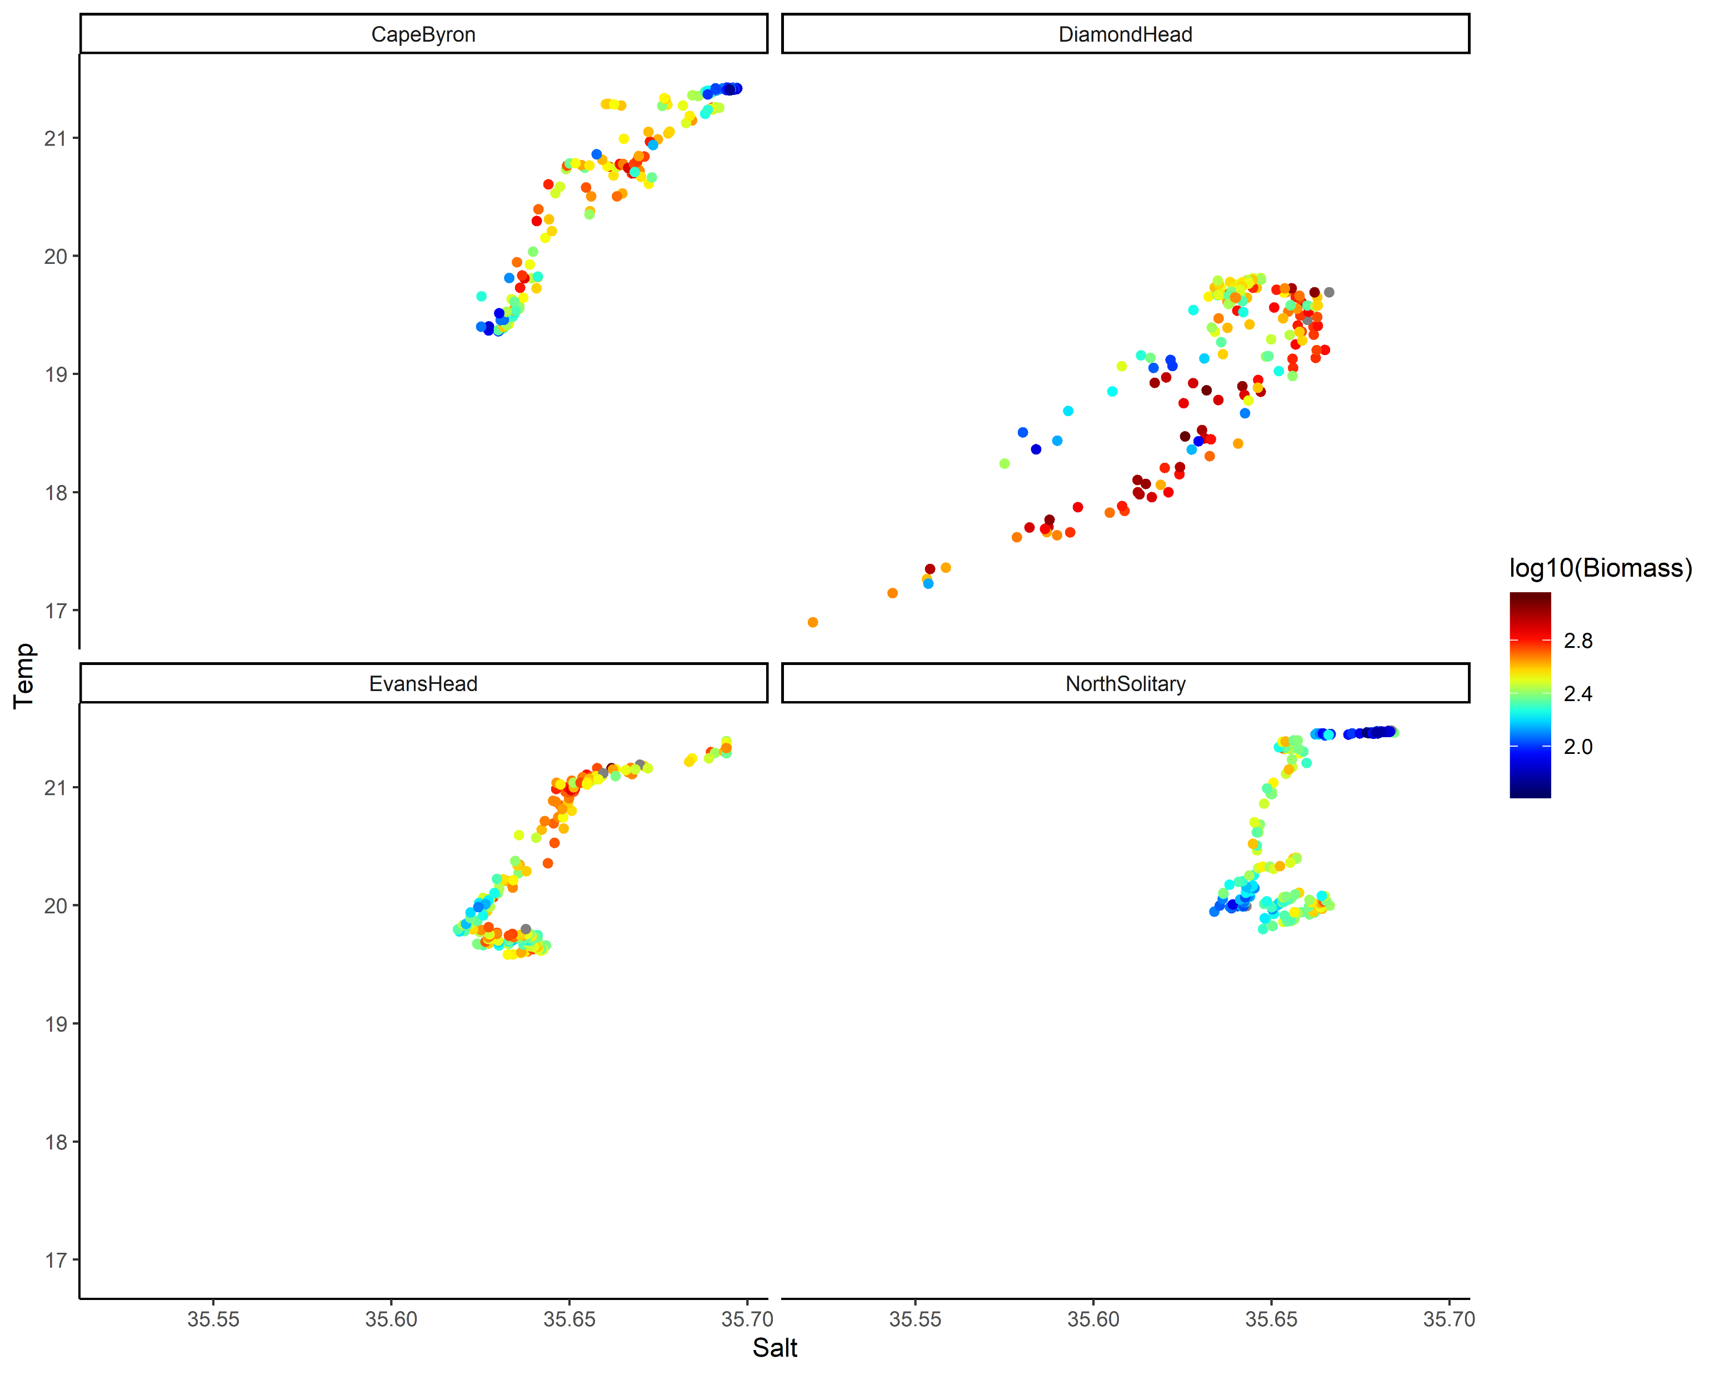
TS Plot by log₁₀(Biomass) top 50m

Slide 42
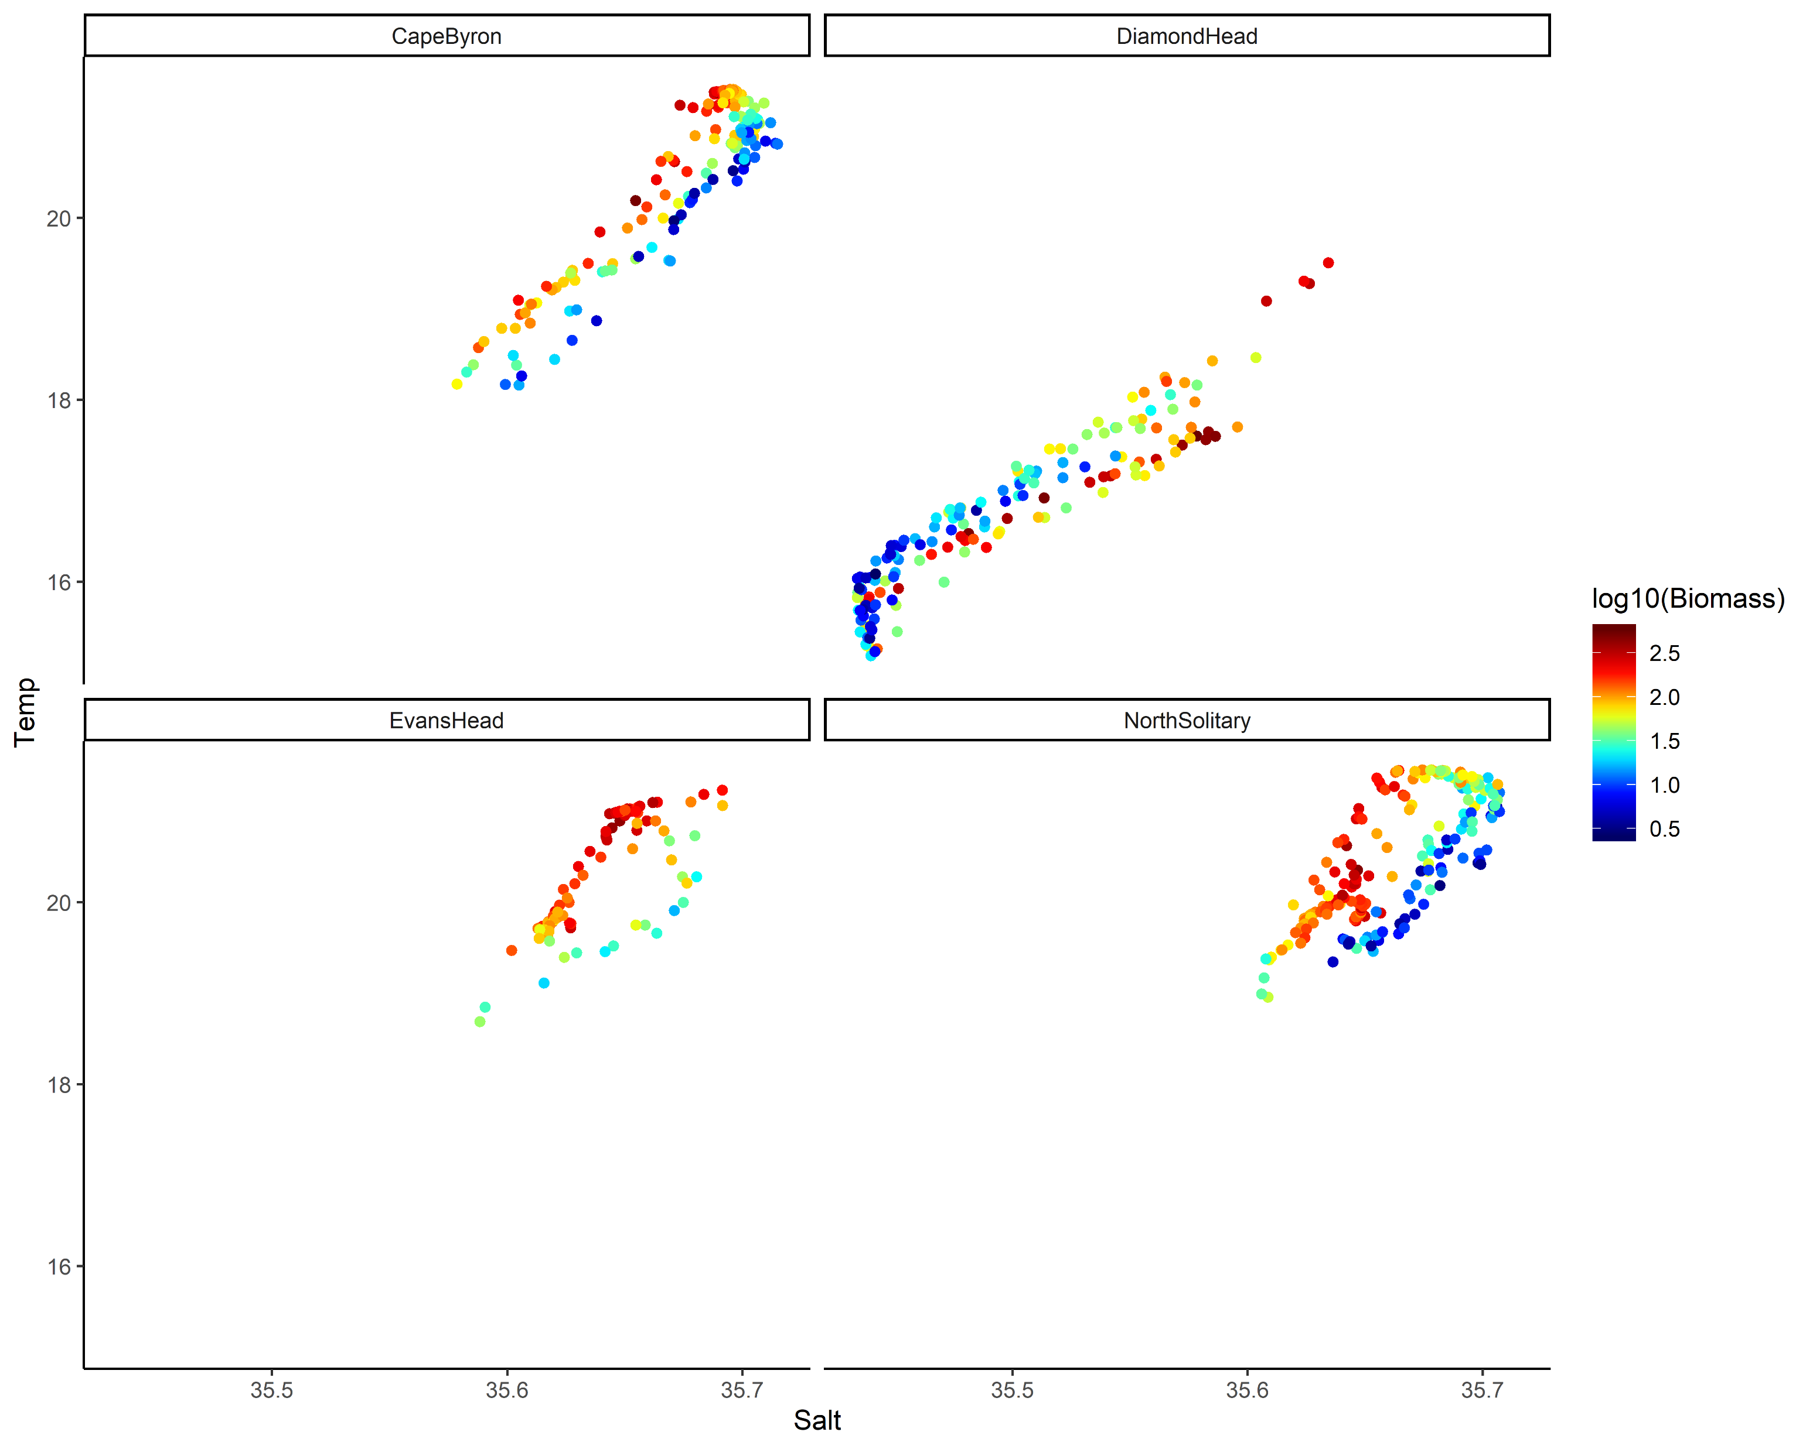
TS Plot by log₁₀(Biomass) below 50m

Slide 43

TS plot by Depth

Slide 44

TS plot by Nitrate

Slide 45




U vectors
m s⁻¹
m s⁻¹
m s⁻¹
m s⁻¹

Slide 46
U vectors – shoreline rotated (m s⁻¹)

Slide 47




V vectors
m s⁻¹
m s⁻¹
m s⁻¹
m s⁻¹

Slide 48
V vectors – shoreline rotated (m s⁻¹)

Slide 49

ADCP Velocity on a map

Slide 50



Nitrate

Slide 51



Silicate

Slide 52



Oxygen

Slide 53



Oxygen utilisation (expected – observed)
um/kg
Positive = respiration (lower O₂ than expected)
Negative = photosynthesis / production
um/kg
um/kg

Slide 54



Salinity

Slide 55



Temperature
Deg C
Deg C
Deg C

Slide 56



Chl_a

Slide 57



Chl_a top 200m

Slide 58



Nitrate

Slide 59



Silicate

Slide 60



Oxygen

Slide 61



Oxygen utilisation (top 200m)
um/kg
Positive = respiration (lower O₂)
Negative = photosynthesis / production
um/kg
um/kg

Slide 62



Salinity

Slide 63



Temperature

Slide 64

Zooplankton Biomass temperature contours

Slide 65
Zooplankton Biomass

Slide 66




NBSS Slope

Slide 67
Pareto Slope

Slide 68

Abundance

Slide 69




Abundance

Slide 70
Geometric Mean Size

Slide 71
Wind Stress
DH
EH
CB

Slide 72

Modelling Zooplankton Biomass
Call: lm(formula = Biomass ~ Temp + Salt + Depth + site + Distance_Coast, data = mydata)
All variables significant except Salinity (P = 0.25)
Adj R² = 0.58
No autocorrelation taken in account ☹

Slide 73

Modelling Pareto Slope
Call: lm(formula = ParetoSlope ~ Temp + Salt + Depth + site + Distance_Coast, data = mydata)
All variables significant except Depth (P = 0.25)
Adj R² = 0.33
No autocorrelation taken in account ☹

Slide 74
Expectations
Areas of upwelling should have higher nutrients and plankton abundance
Areas offshore (open ocean water) should have slopes closer to -1
Southern sites should have higher biomass (colder water influence)

Slide 75
Patterns
Inshore North Solitary shows some upwelling + higher nutrients + biomass
North Solitary, Evans Head and Cape Byron have high surface biomass offshore (but not abundance?) – this is weird Data error
Abundance (and biomass) increases towards the shelf (I think this is common but relatively unpublished?)

